Slide 1
Interdependence in Difficult Times
“5+5” Meeting of Finance Ministers
Malta, April 6, 2017
Uri Dadush
OCP Policy Center
Bruegel

Slide 2
This presentation reflects only the views of the author and not of the institutions with which he is affiliated.
The presentation draws in part from a recent joint paper with Maria Demertzis and Guntram Wolff at Bruegel. Bingying Wu provided research assistance. Support of this work by the World Bank is gratefully acknowledged.

Slide 3
Vital Statistics
The Southern Mediterranean Countries (SMC) are home to 95.9 million people, and their combined GDP in 2016 was $362 billion. Their GDP per capita (in US $ PPP) is $14,857 for Algeria, $14,349 for Libya, $4,515 for Mauritania, $8,350 for Morocco, and $11,652 for Tunisia.
The Northern Mediterranean Countries (NMCs) – France, Italy, Malta, Portugal, and Spain - are home to 182.9 million people, and their combined GDP is $5,771 billion. Their median GDP per capita (in US $ PPP) is $36,191.
Approximately half of the trade of the SMC is with the NMC and NMCs are the main source of FDI into SMCs. SMCs trade very little with each other.
NMCs are the main destination of SMC migrants; Morocco and Tunisia receive remittances equal to 7% of GDP and 4% of GDP respectively

Slide 4
Difficult Times
Growth in the NMCs has been among the lowest in the world since 2008 and with the sovereign debt crisis in Europe, current account balances in the NMCs have turned sharply positive, mainly due to import compression, and world trade has slowed sharply.
Total employment in the NMCs declined by 2.4 million since 2008, and net migration from the SMCs to the NMCs is close to zero (though SMCs are a migration channel from Sub-Saharan Africa to the NMCs).
Algeria and Libya depend almost exclusively on oil and gas exports, mainly destined to the NMCs, but oil prices were halved in 2014-15. Mauritania has seen a sharp decline in the prices of its metal exports. The Arab uprisings have had a chilling effect on private investment in the SMCs.
Anti-globalization movements in Europe have gained strength, challenging trade deals, migration and refugee policies, the Euro, and the institutions of the European Union. The nationalist policies of the new US Administration add another layer of complexity

Slide 5
Growth slowed sharply in the SMCs after the Arab uprisings and as the Euro crisis festered

Slide 6
Imbalances Deteriorated in Most SMCs
-47.4%
-21.9%

Slide 7
Moderate Growth Recovery Expected

Slide 8
Two Specific Challenges in the SMCs
Entering Global Value Chains/ Diversification
Reducing Youth Unemployment
….these challenges are linked and meeting them is of interest to the NMCs as well.

Slide 9
Challenge 1: Joining Global Value Chains and Achieving Diversification

Slide 10
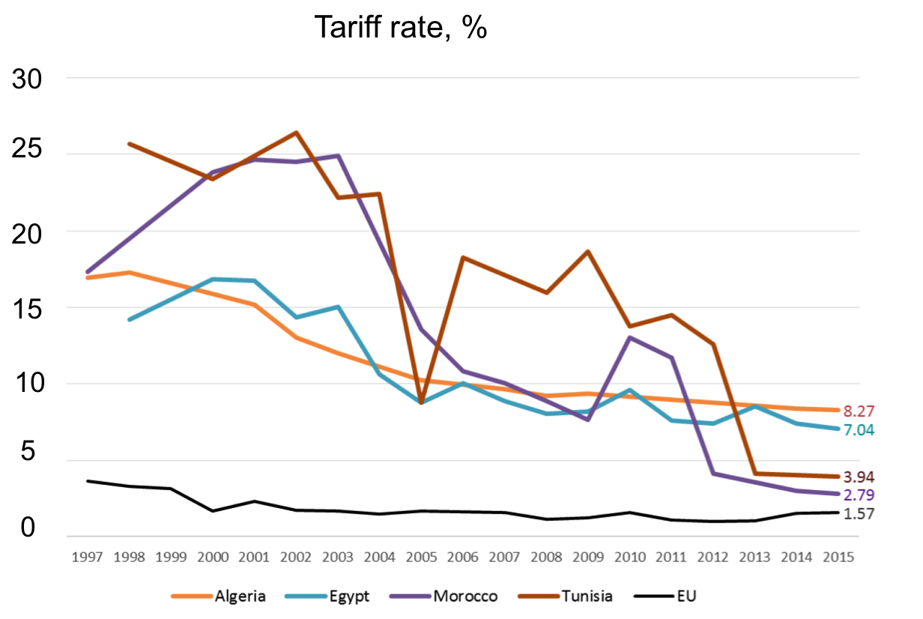
There has been much trade liberalization

Slide 11
Main constraints facing the MENA private sector (6000 firms, 8 countries)
Source: The World Bank, Enterprise Surveys, What’s Holding Back The Private Sector in MENA?

Slide 12
Political Stability and Economic Outcomes
So long as severe political instability persists, economic outcomes will continue to disappoint.
The divisions in the SMCs are mainly internal, and they are deeper than many in the West appreciate.
They are about voice and inequity, the secular vs the religious state, the prevalence of specific creeds, the role of women, and control of natural resources.
Differences can only be mediated internally and it can take a long time to resolve them. External actors cannot determine outcomes, but they can sometimes help point the way through advocacy and by calibrating their support.
Resolving profound differences does not depend only or mainly on economic policy, but political stability is easier to achieve when firms are profitable and growing, people have jobs and they see a future for their children.

Slide 13
Diversity within the sample: Morocco and Tunisia
In Morocco, more than 20% of firms complain of corruption as a major obstacle, nearly 15% of difficulty in finding skills needed and less than 10% of political instability.
In Tunisia, some 50% of firms list political instability as their key concern, while less than 10% complain of skill shortage and less than 5% complain of corruption.

Slide 14
Selected Findings From the Enterprise Surveys
Firms have higher labor productivity and are more capital intensive than in peer countries …but firms face a tougher environment than in peer countries, and this is especially hard on small firms
Firms tend to be old, small, and to stay small (low mobility up or down)
Competition is often limited and “connected” large firms have easier access to finance and other advantages
Formal private sector in the SMCs is small (30% of GDP?), placing a ceiling on high-value-added economic activity, innovation, and the capacity to participate in complex international value chains.

Slide 15
Source: World Bank 2017 Ease of Doing Business report. Data refer to the world ranking of the selected countries.

Slide 16
Source: World Bank 2017 Ease of Doing Business report. Data refer to the world ranking of the selected countries.

Slide 17
Impediments to Joining GVCs/Diversification
Comparatively weak business environment
Overvalued exchange rates
Inefficiency or absence of support sectors
Disappointing outcomes of trade agreements
Competition from Eastern Europe
Lack of integration within the SMCs

Slide 18
Challenge 2: Reducing Youth Unemployment

Slide 19
Youth unemployment, and underemployment generally, remains high…

Slide 20
…despite sharp deceleration in the population of working age…
Source: UN Data, Population aged 15- 64 Medium Variant.

Slide 21
Labor force will decelerate further in most SMCs: opportunity to reduce youth unemployment?
Source: UN Data, Population aged 15- 64 Medium Variant.

Slide 22
Tackling the root causes of youth unemployment
Growth low and outlook uncertain
Growth is “too” capital intensive
Skills are inadequate
Entry into the formal sector is restricted
…dual labor markets, low growth and inadequate skills also pose challenges in the NMCs

Slide 23
Issues Arising
What can the SMCs do to improve their business climate, promote investment, and integrate more with each other?
Can the SMCs take better advantages of the demographic transition, invest in marketable skills, and create enough jobs for the young, thus mitigating the causes of discontent?
Can the NMCs do more to help through trade, migration, and aid policies? Can they work together with SMCs on promoting value chains? Are DCFTA’s enough?
Can more be done to exploit synergies in specific areas, such as in the field of energy and on the Compact for Africa?

