Slide 1
Zombies, exit policies and productivity
Dan Andrews and Giuseppe Nicoletti
Structural Policy Analysis Division
Economics Department
Bruegel | 6 December 2017

Slide 2
Results from the project on:
Exit Policies and Productivity Growth
Based on research by:
Müge Adalet McGowan, Dan Andrews, Valentine Millot, Filippos Petroulakis, Alessando Saia

Slide 3
Motivation why exit policies and productivity?

Slide 4
A revival of OECD productivity is badly needed
Contributions to potential per capita output growth (% pa)
Pre-crisis: MFP story
Post-crisis: K story
Source: OECD EO live December 2017

Slide 5
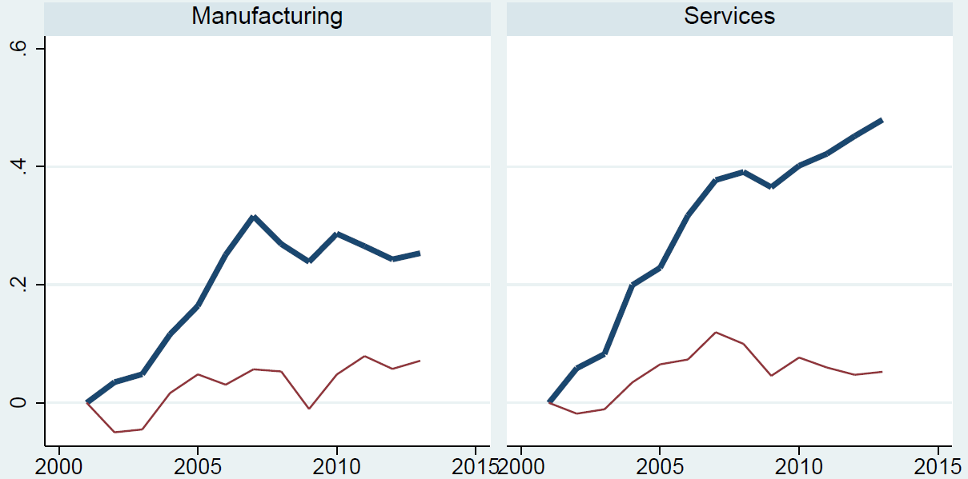
Looking beyond averages, the slowdown comes from laggards
Average of multifactor productivity across sectors (log, 2001=0)
Frontier
Frontier
Laggards
Laggards
Source: Andrews, D. C. Criscuolo and P. Gal (2016), “The Best versus the Rest: The Global Productivity Slowdown, Divergence across Firms and the Role of Public Policy”, OECD Productivity Working Papers, No. 5.

Slide 6
Weak firms are an increasing burden: what can policy do?
Three stylised facts emerge:
  Rising productivity dispersion
  Declining efficiency of reallocation
  Declining business dynamism (less entry and more zombie firms)
Notes:
why focus on insolvency regimes and zombie firms?
Aggregate data conceal micro-level patterns that raise a red flag that there may be trouble on the exit margin:
Rising dispersion: productivity performance of frontier firms has been much stronger than that of laggards; the diffusion machine has broken down
Declining reallocation: the propensity for high-productivity firms to expand and low-productivity firms to contract or exit has declined over time
Declining business dynamism: firm entry has declined while weak firms are increasingly surviving
Policy conditions are conducive in some countries:
Impaired banking sectors, ultra loose monetary policy
Crisis-induced SME support not yet withdrawn
Weak insolvency regimes + waning structural reform ambition

Slide 7
The Walking Dead: zombie firms on the rise
Firms aged ≥10 years with an interest coverage ratio<1 over 3 consecutive years
Unweighted average across selected OECD countries
Conclusions are robust to alternate measures of zombie firms (see slide A1)
Source: Adalet McGowan, M., D. Andrews and V. Millot (2017), “The Walking Dead? Zombie Firms and Productivity Performance in OECD countries”, OECD Economics Department Working Paper No. 1372.

Slide 8
Weak firms are an increasing burden: what can policy do?
Three stylised facts emerge:
  Rising productivity dispersion
  Declining efficiency of reallocation
  Declining business dynamism (less entry and more zombie firms)
This points to policies that affect the exit or restructuring of weak firms
But most data and evidence is about entry!
Notes:
why focus on insolvency regimes and zombie firms?
Aggregate data conceal micro-level patterns that raise a red flag that there may be trouble on the exit margin:
Rising dispersion: productivity performance of frontier firms has been much stronger than that of laggards; the diffusion machine has broken down
Declining reallocation: the propensity for high-productivity firms to expand and low-productivity firms to contract or exit has declined over time
Declining business dynamism: firm entry has declined while weak firms are increasingly surviving
Policy conditions are conducive in some countries:
Impaired banking sectors, ultra loose monetary policy
Crisis-induced SME support not yet withdrawn
Weak insolvency regimes + waning structural reform ambition

Slide 9
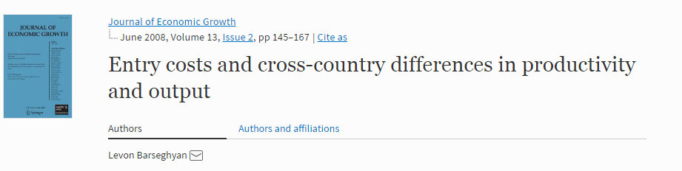
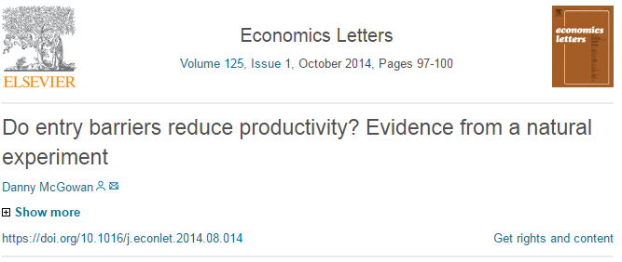
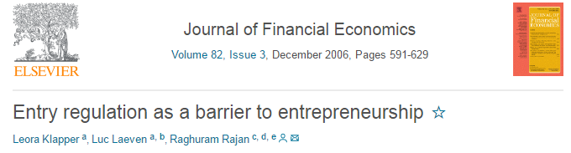
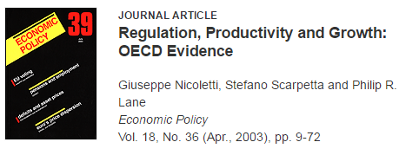

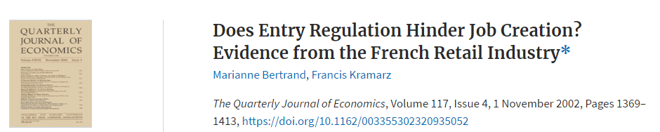
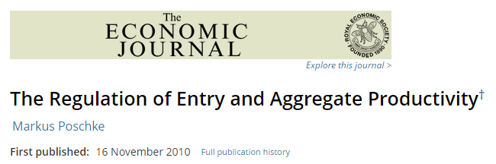
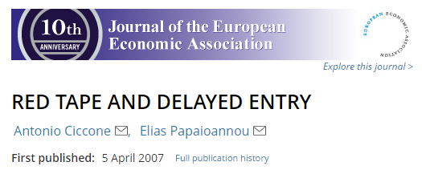
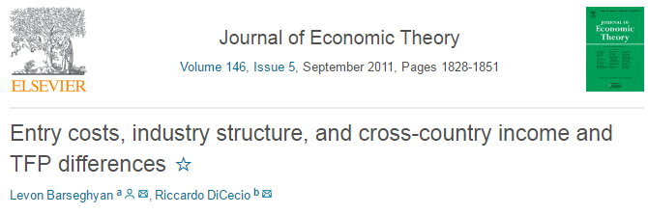
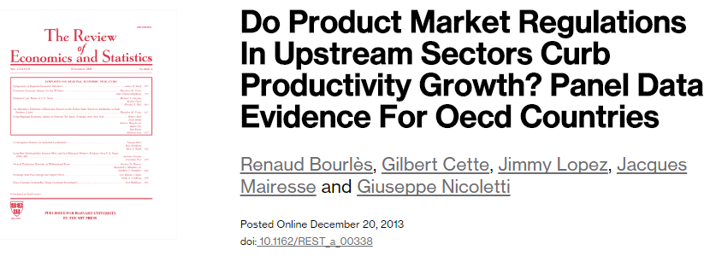

Slide 10
The OECD contribution
  Relevance of insolvency regimes for aggregate productivity: channels and mechanisms
  Cross-country comparison of effectiveness of insolvency regimes: stigma, barriers to restructuring
  Scope for exit policy reform to revive productivity growth: a granular and complementary approach
Much scope to revive productivity growth by promoting easier exit or restructuring
Complementarity across insolvency, financial and other reforms is large
The social costs can be contained via labour market policies

Slide 11
The problem weak firms are stifling productivity growth

Slide 12
Zombies absorb an increasing share of labour and capital
Firms aged ≥10 years and with an interest coverage ratio<1
over three consecutive years
Source: Adalet McGowan, M., D. Andrews and V. Millot (2017), “The Walking Dead? Zombie Firms and Productivity Performance in OECD countries”, OECD Economics Department Working Paper No 1372.

Slide 13
Why do zombie firms matter for aggregate productivity?
Delaying their exit or restructuring:
Drags down average (unweighted) productivity
Stifles reallocation: by consuming scarce resources they congest markets, undermining growth opportunities for healthier firms
Deters entry of potentially innovative young firms
When more capital is sunk in zombie firms:
The typical healthy firm invests less (↓ K deepening)
Particularly so young and more productive firms (↓ MFP)

Slide 14
Zombie firms congest markets and hamper labour productivity…
Estimated gains from reducing zombie capital share to minimum level
A: Business investment
B: Multi-factor productivity

Slide 15
… by crowding-out credit availability to healthy firms
Average bank loan availability for healthy firms for
each bin of zombie congestion
Healthy firms report greater difficulty accessing credit when they operate in sectors where more capital is sunk in zombie firms
Source: D. Andrews and F. Petroulakis (2017), “Breaking the Shackles: Zombie Firms, Weak Banks and Depressed Restructuring in Europe”, OECD Economics Department Working Papers, No. 1433.

Slide 16
What to do?
Insolvency reform

Slide 17
Insolvency regimes and productivity: understanding the link
Insolvency regimes are crucial for firm exit and restructuring since they can bring debtors and creditors to the table to deal with financial distress in an orderly fashion.
Thus, they can affect aggregate growth via reallocation and firm exit but also in terms of the types of firms that enter and the nature of their business strategies.
BUT the limitations of existing policy indicators constrain cross-country research on insolvency regimes and growth
A new OECD policy questionnaire yielded harmonised cross-country indicators on the key design features of insolvency regimes that impact the timely initiation and resolution of proceedings

Slide 18
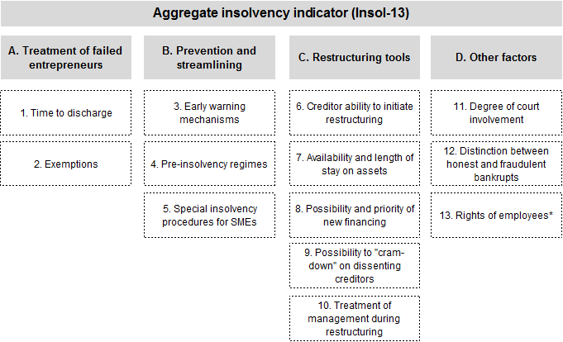
New data: improving the measurement of insolvency regimes

Slide 19
Much scope to improve the design of insolvency regimes
Composite indicators of insolvency regimes, 2010 and 2016
Increasing in barriers to exit or restructuring

Slide 20
Insolvency reform can revive productivity growth
Insolvency reform can address three structural sources of productivity weakness:
Reduce the capital sunk in zombie firms via:
  Exit of zombie firms
  Rehabilitation of weak firms thus implying lower social costs to job churn than if only exit was envisaged
Reallocation of capital to more productive firms
Productivity growth of laggard firms via more efficient technology diffusion

Slide 21
Insolvency reform can reduce zombie congestion and boost reallocation…
Estimated gains from reducing barriers to restructuring (BTR) to minimum level
A: Reduction in zombie capital share (ZKS)
%
B: Gain to productivity-enhancing capital reallocation

Slide 22
… and revive MFP growth in laggards via technological diffusion
Estimated gains from reducing barriers to restructuring (BTR) to minimum level
Gain to laggard firm multi-factor productivity growth
Technology adoption requires organisational change, which is easier when barriers to corporate restructuring are low.
Insolvency reform can also raise the MFP gains from reducing regulatory entry barriers (slide A2).

Slide 23
What to do?
FINANCIAL REFORM

Slide 24
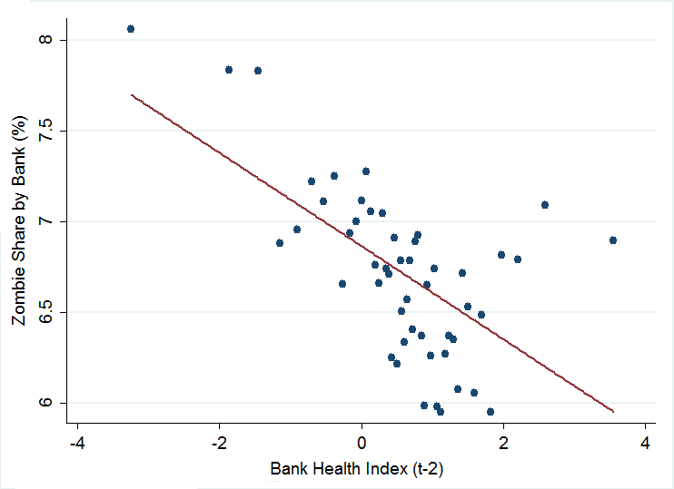
Zombie firms survive due to bank forbearance: NPL resolution is key
Average zombie share for each bin of bank health
Purged of country-industry-year fixed effects
Weak banks increase the survival of zombie of firms and distort capital allocation
Source: D. Andrews and F. Petroulakis (2017), “Breaking the Shackles: Zombie Firms, Weak Banks and Depressed Restructuring in Europe”, OECD Economics Department Working Papers, No. 1433.

Slide 25
… insolvency reform enhances the effectiveness of NPL resolution
If bank health improves*, how much more would the zombie firm
share decline if barriers to restructuring were at the minimum level?
Improvements in bank health translate into larger reductions in the zombie firm share when insolvency regimes promote restructuring
Insolvency reform can reduce banks incentives to engage in forbearance
*Shock to bank health = 2 standard deviations
Source: D. Andrews and F. Petroulakis (2017), “Breaking the Shackles: Zombie Firms, Weak Banks and Depressed Restructuring in Europe”, OECD Economics Department Working Papers, No. 1433.

Slide 26
Promoting equity financing can revive productivity diffusion
Gain to laggard firm annual MFP growth from financial reform
Raising VC financing to sample maximum
Reducing debt-bias to sample minimum
Source: Adalet McGowan, Andrews and Millot (2017), “Insolvency regimes, technology diffusion and productivity growth: evidence from firms in OECD countries”, OECD Economics Department Working Papers No. 1425.

Slide 27
What to do?
Activation policies

Slide 28
Coping with creative destruction
Policies that promote corporate restructuring intensify job/firm churning, implying:
  Benefits: ↑ job growth of non-zombies; better matching
  Costs: ↑ job destruction → political economy barriers to structural reform if left unaddressed.
Workers displaced by firm exit more likely to return to work when:
  Labour market expenditures are tilted more towards active measures – i.e. retraining, job placement (ALMPs) – relative to passive measures – i.e. long-lasting UE benefits.
  Policy promotes residential mobility – i.e. tax wedge and transaction taxes in housing markets are lower.
  ALMPs more effective when public sector efficiency is higher and regulatory entry barriers in product markets are lower

Slide 29
Entry reform enhances the bang-for-the-buck of ALMP spending
Impact of increasing ALMPs by 0.25%pts of GDP on re-employment probability of workers displaced by firm exit
ALMPs are more effective when firm entry barriers are low as jobs are more abundant when new firms can enter the market and grow.
Source: Andrews and Saia (2016), “Coping with Creative Destruction: Reducing the Costs of Firm Exit”, OECD Economics Department Working Paper, No 1353.

Slide 30
Conclusion

Slide 31
The corporate restructuring path to higher productivity growth
Productivity growth can be revived by:
Insolvency regime reform to reduce barriers to corporate restructuring and the personal costs of business failure
Restoring bank health and promoting non-bank financing by ↓ debt bias in corporate tax systems
Simultaneously pursue insolvency reforms with initiatives to reduce regulatory entry barriers and NPLs.
Since these reforms will amplify job/firm churning, they should be flanked by well-designed ALMPs
Reduce regulatory entry barriers to getting value for money from labour market spending.

Slide 32
Technical background papers
Adalet McGowan, M. & D. Andrews (2018), “Design of Insolvency Regimes across Countries”, OECD Economics Department Working Papers, forthcoming.
Andrews, D. & F. Petroulakis (2017), “Breaking the Shackles: Zombie Firms, Weak Banks and Depressed Restructuring in Europe”, OECD Economics Department Working Papers, No. 1433.
Adalet McGowan, M., D. Andrews & V. Millot (2017), "Insolvency Regimes, Technology Diffusion and Productivity Growth: Evidence from Firms in OECD Countries", OECD Economics Department Working Papers, No. 1425.
Adalet McGowan, M., D. Andrews & V. Millot (2017), “Insolvency regimes, zombie firms and capital reallocation”, OECD Economics Department Working Papers, No. 1399.
Adalet McGowan, M., D. Andrews & V. Millot (2017), “The Walking Dead?: Zombie Firms and Productivity Performance in OECD Countries”, OECD Economics Department Working Papers, No. 1372.
Andrews, D. & A. Saia (2017), "Coping with creative destruction: Reducing the costs of firm exit", OECD Economics Department Working Papers, No. 1353.
Adalet McGowan, M. & D. Andrews (2016), “Insolvency Regimes And Productivity Growth: A Framework For Analysis”, OECD Economics Department Working Papers, No. 1309.

Slide 33
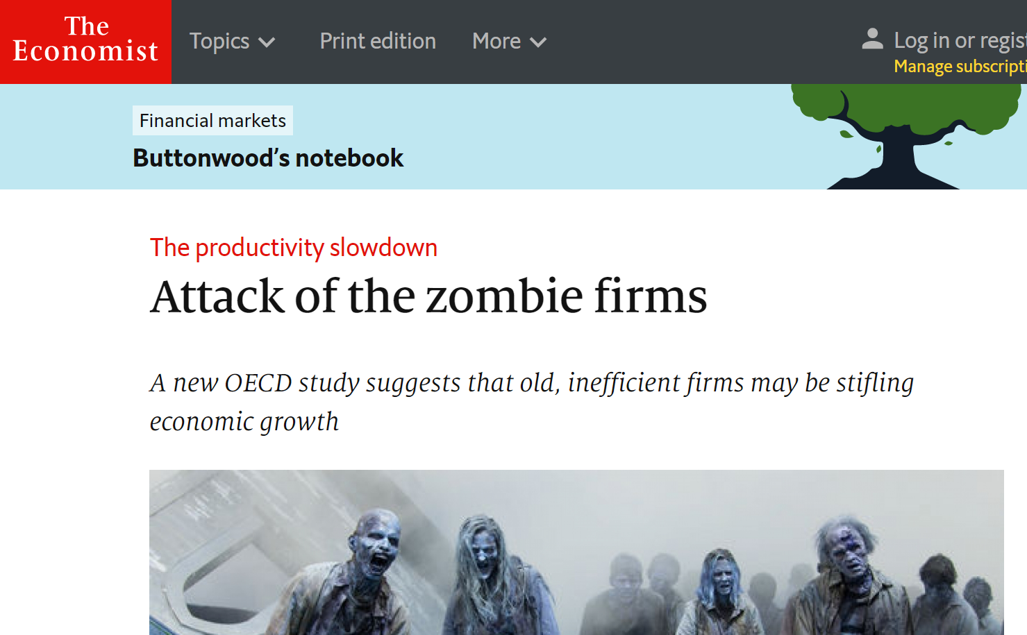

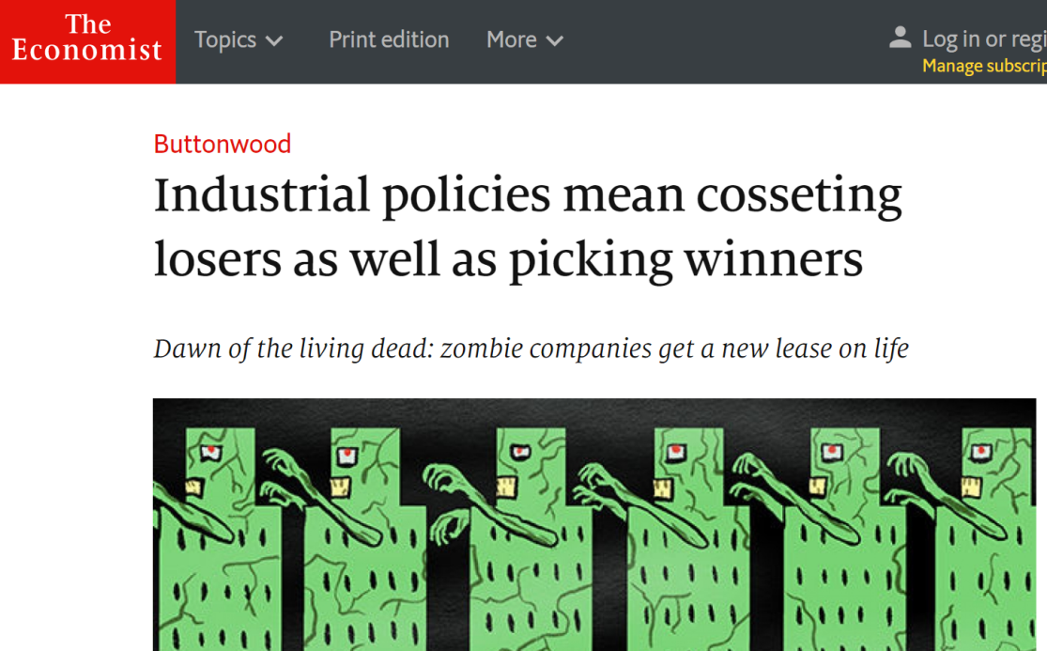
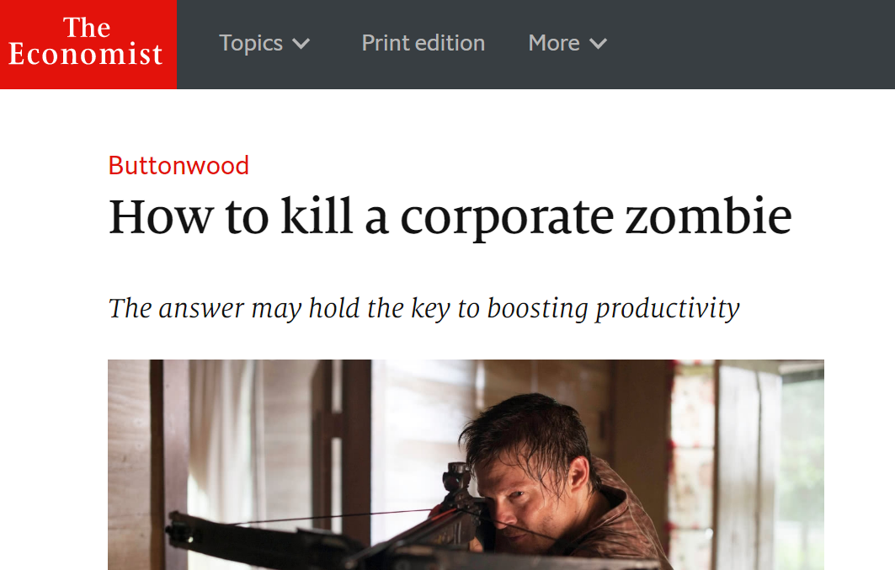
Selected media

Slide 34
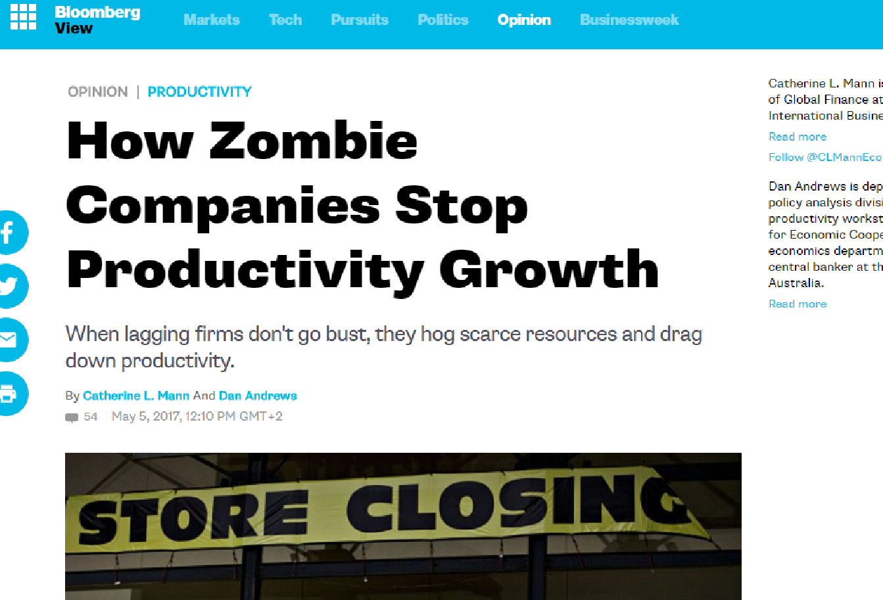



Selected media (continued)

Slide 35
Appendix

Slide 36
A1. What are zombie firms and how to identify them?
Zombie firms are firms that would typically exit in a competitive market but nonetheless survive.
Approach 1: Persistent financial weakness (Bank of Korea)
Old incumbent firms (≥10 years) with interest coverage ratio<1 for 3 consecutive years
Approach 2: Firms receiving subsidized bank credit (Caballero et al., 2008)
Actual interest repayments < estimated benchmark R* based on the firm debt structure and market interest rates
Our main econometric conclusions are robust to both measures. We focus on Approach 1 for simplicity and to maximise data coverage.

Slide 37
A2. Insolvency reform raises the productivity gains of entry reform
Gain to laggard firm MFP growth from reducing adm. burdens on start-ups
Reducing the personal costs of entrepreneurial failure encourages more experimentation and create sufficient space for new entrants to grow
Source: Adalet McGowan, Andrews and Millot (2017), “Insolvency regimes, technology diffusion and productivity growth: evidence from firms in OECD countries”, OECD Economics Department Working Papers No. 1425.

