Slide 1
China and US trade war and beyond:
What can Europe do?
Alicia Garcia Herrero
Research fellow at Bruegel
alicia.garciaherrero@bruegel.org
June 2018

Slide 2
Key issues
US containing China with trade
But also with other means, such as trade and even corporate taxes
What can Europe do?

Slide 3
US containing China with trade

Slide 4
Tic-Tac-Toe game on trade between the US and China US not really looking to settle
Type of Product | Solar panels/ Washing machines | Steel / Aluminum | Intellectual Property (1102 products valued at USD 50bn) | Autos / Automotive Parts
Rules | Section 201 Import Relief for Domestic Industries | Section 232 National security | Section 301 Intellectual property laws | Section 232 National security
Effective Date | 7th Feb | 23rd Mar | 25% additional duty effective on July 6 for 818 products (worth 34bn) included in the proposed list on April 6, and 284 products (worth 16bn) will undergo further review. | Under further review
Exemption | “GSP-Eligible” developing nations¹ | Australia, Argentina, Brazil and South Korea² | Targeted at China | TBC
Applied to China | √ | √ | √ | √
Retaliation from China | N/A | Tariffs on $3 billion of 128 products including pork, fruit, nuts and wine of up to 25% | 25% duty effective on July 6 for 545 products valued at about $34 billion and 114 products valued at about $16 billion with no effective date announced | TBC
N.B. 1 Philippines and Thailand are not excluded, even though they are GSP-Eligible. 2 Exclusions from US steel and aluminum tariffs may take 90 days
Source: Natixis, U.S. Government

Slide 5
With tariffs based on intellectual property, US is targeting at China’s future will China is targeting US past

Slide 6
More specifically, the US wants to hurt China’s high-tech sector while protecting its consumers. China cannot afford targeting high-end products, especially aircraft
A comparison of the new lists and the earlier lists released by the US and China reveals that the US exempts a long list of white goods from tariffs while adding semiconductors to the new list.
China, on the other hand, excludes aircraft (used to be the second largest component in the list) from the targeted products. Soybeans and vehicles continue to be the largest components in China’s tariff list.
Comparison of the new and old lists for the 50 billion products (key products by value)
 | New | Removed
China | (561 products) Petroleum and gases Medical appliances | (8 products) Aircraft
US | (284 products) Semiconductors and parts | (515 products) White goods and parts

Slide 7
What to learn from US past protectionism?:
Legal instrument used relevant
Two main tools of US trade act on intellectual property protection violation: Section 301 and Section 337
Section 301 had hardly been used in recent times (after WTP international dispute settlement system approved, which is a substitute of 301)
Since then, mainly Section 337 used. Then why 301 used this time?

Slide 8
How much has China been a target?
China was not an apparent US target for 301 investigations. More were targeted at EU and others.
However, 337 investigations have been increasingly targeted towards China

Slide 9
Why has US preferred Section 301 this time?: To target China’s future
Investigation could be launched without waiting for applicants
Much broader set of industries can be targeted versus one specific industry for 337 investigation
Products not yet exported to US could be included in US list as 301 can be applied extraterritorially to protect US in other markets.
Latter helps US with final objective with trade war, namely to target China’s future production capacity rather than only present
The US Section 301 Investigations against China in the past

Slide 10
But also with other means, such as trade and even corporate tax taxes

Slide 11
US also limiting China’s ability to buy its technology…
This is why China is going to Europe

Slide 12
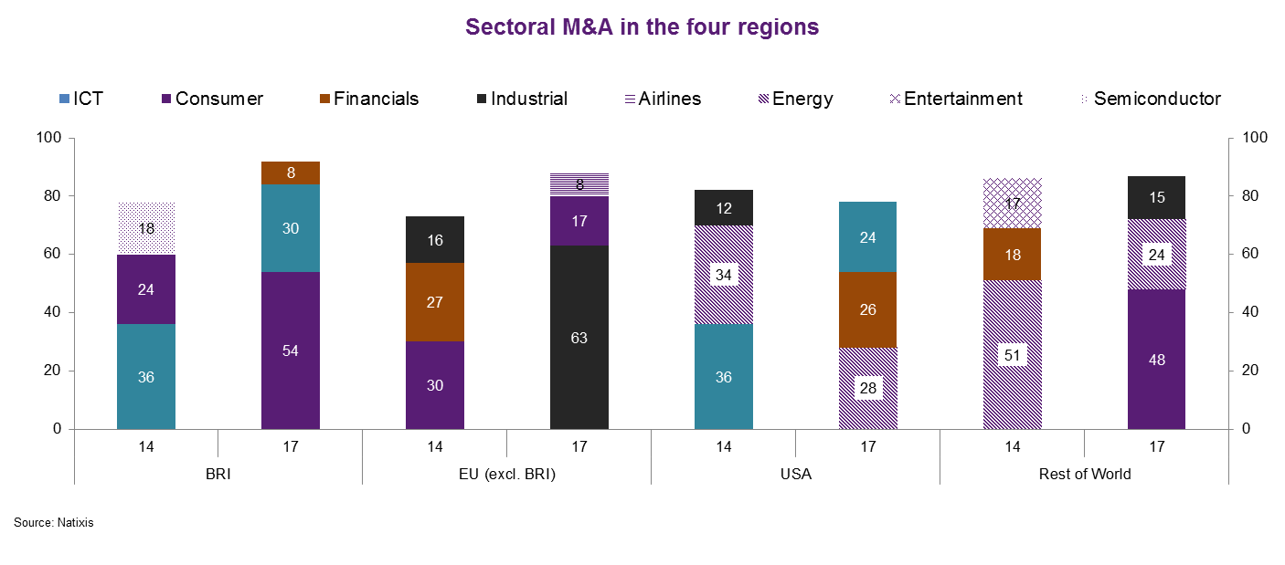
Technology related to industrial sector has become the key target of Chinese M&A into Europe. ICT preferred in US but also financial and energy sectors
Industrial M&A seems to diminish in the US, but start to be prevalent in the EU.
Consumer sector has been expanding rapidly in the non-EU and USA region, especially in the Belt and Road.

Slide 13
International consequences US’ corporate tax reform probably also linked to containing China
Although China’s officially standard corporate tax rate is 25% but this is really a maximum and there are a number of ways to lower it
In effective termswhen including value added taxes, China’s effective tax rate only 17%, much lower than US new corporate tax ratio alone.
China’s official corporate income tax rate
Base rate | 25%
Small enterprises that satisfy certain criteria | 20%
Recognized high-tech firms | 15% (2-year exemption)
Non-resident firms | 20%

Slide 14
But really hard for US to be a threat to China based on tax competition
For domestic firms, less relevant due to capital control and government implicit subsidies
For foreign companies, China can still afford to lower the corporate income tax as it is a very small part of the tax base. Furthermore, China has already announced a temporarily exemption for foreign firms from taxes for reinvested profits.

Slide 15
What can Europe do?

Slide 16
Focusing on direct impact, Europe could become the key loser of a trade deal between the US and China
If China were finally to accept a massive import bill from the US (say USD 200 billion as discussed), China would need to divert imports away from other parts of the world. EU as main target being a key competitor of US products for several sectors.

Slide 17
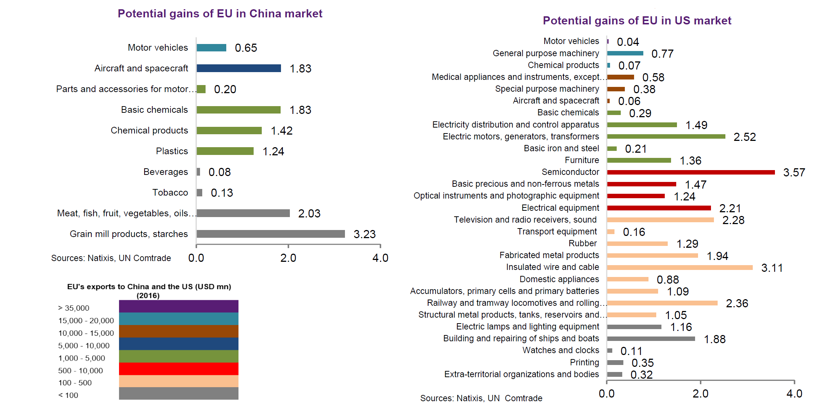
Instead, EU could gain in relative terms, if China and US continue with their trade war. This is only true if EU does not take. sides

Slide 18
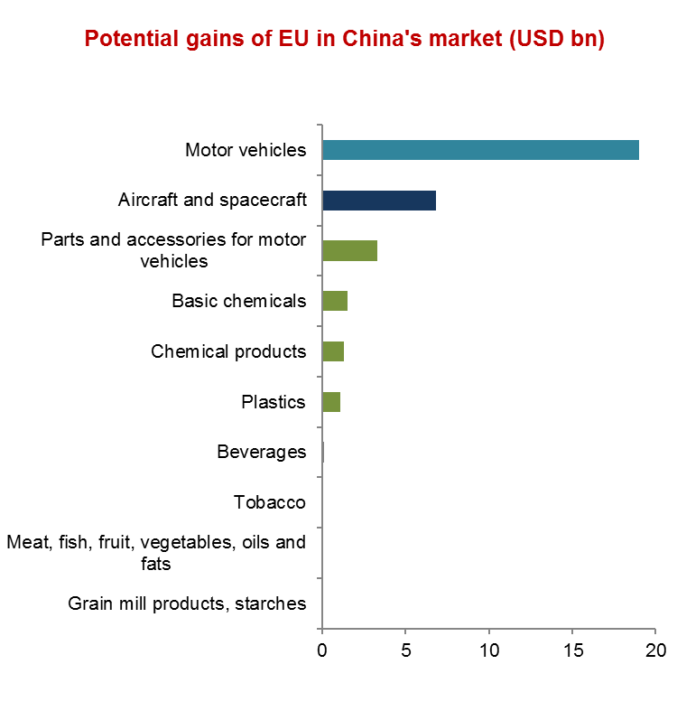
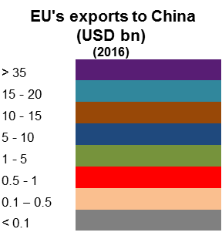
European industries’ potential market in China if China/US import tariffs are imposed

Slide 19
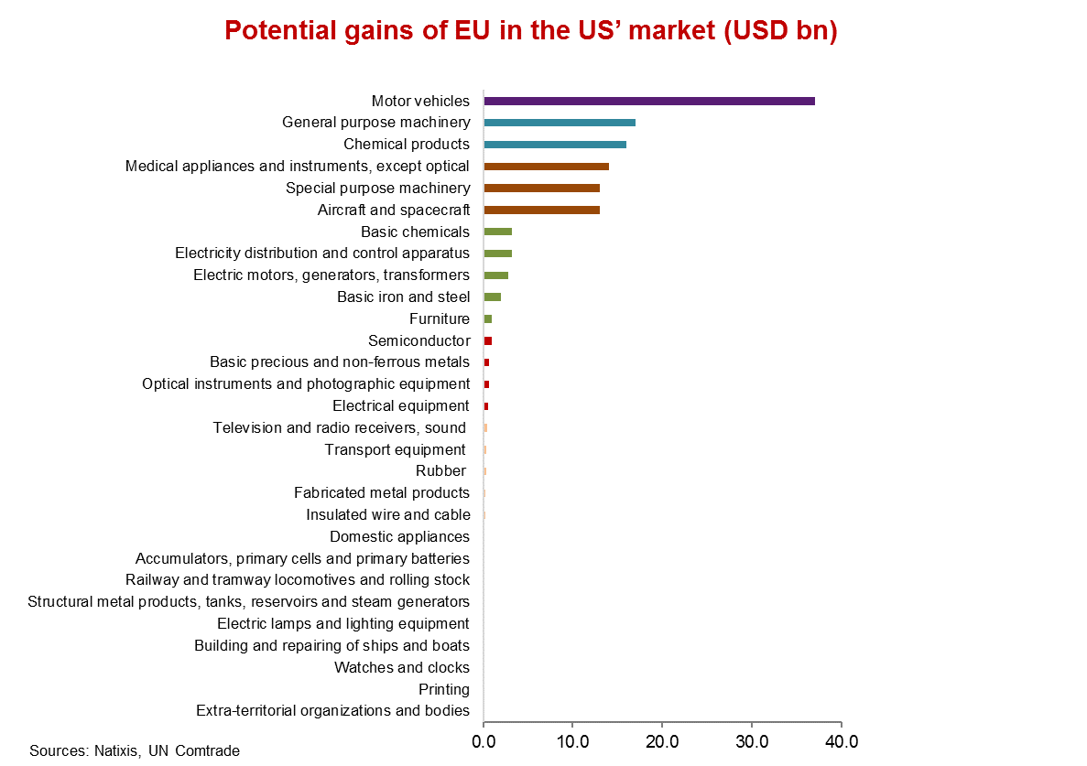

European industries’ potential market in US if China/US import tariffs are imposed much bigger and more broadbased

Slide 20
How can EU play the mid-field game as the world becomes dominated by two hegemons in a tech arms race?
EU could move away from a one-sided position anchored on the transatlantic alliance if it wants to profit from a mid-field role.
However, China should offer enough for EU to take that risk.
So far EU gains more from US trade relation than from China.
For China to entice EU, at least for trade, more is needed.
  Market access and reciprocity being key but also a change in corporate governance which cannot happen with China reducing the role of the state in the economy.
  China’s unwillingness to take these actions may now change as US containment could become an existential risk for China’s growth model.

