Slide 1
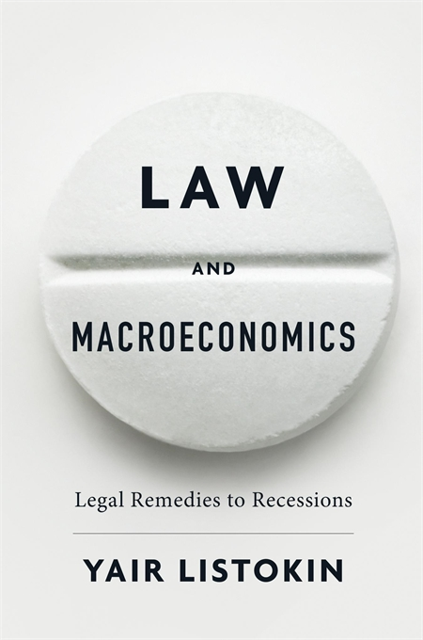

Slide 2
The Great Recession
Stakes:
Tens of trillions in lost output, hysteresis/secular stagnation.
Unequally distributed.
Threat to social/political order.

Slide 3
Responses
1. Do Nothing (Austrians/ institutional pessimists).
2. Monetarism to promote aggregate demand (Friedman).
3. Fiscal Policy to promote aggregate demand (Keynes)
Monetary Policy and Fiscal Policy have lots of virtues (and vices), but often don’t work– sometimes by design.
Are there any other policy options?

Slide 4
Law and Macroeconomics
1. Explore powerful alternative set of legal/regulatory tools for aggregate demand management.
2. Emphasize critical role of law in the making of macroeconomic policy.

Slide 5
Role of Law in the Making of Fiscal and Monetary Policy
Law usually plays little role in monetary policy.
Except when it really matters.
Lehman Brothers in the U.S.
OMT (and possibly QE) in Eurozone.
Fiscal policy generally treated as inferior to monetary policy: Why?
Not an economic argument.
Institutional/legal
Extraordinary power and flexibility has been delegated to central banks.
Lots of benefits, but costs to democracy/legitimacy.
Corollary: careful adherence to limits.

Slide 6
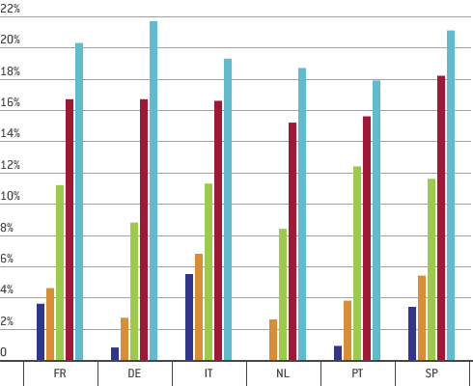
Legality of ECB Programmes
National central bank holdings of domestic sovereign bonds (% of total outstanding sovereign bonds), selected countries
2014-2018
Source: Bruegel
“Monetary financing” of government is prohibited. TFEU Article 123.
OMT
Gauweiler on OMT.
ECJ opinion says “monetary policy.”
QE (see figure).

Slide 7
The Law and Macroeconomics Take
What do I think of what the ECB did and the ECJ approved in OMT?
Incredibly expansive (purposive), reading of the Treaty of Lisbon.
Not a crazy reading: recall the purpose of the Treaty expressed in the preamble:
“to achieve the strengthening and the convergence of [EU] economies and to establish an economic and monetary union including … a single and stable currency
How it was explained and justified?
Inadequate at both ECB and ECJ level.
ECB provided very little until Gauweiler.
Both ECB and ECJ hide the ball.
Central Bank transparency revolution should affect law.
There needs to be some limit.

Slide 8
Fiscal Policy at the Zero Lower Bound
Textbook response vs. Great Recession experience.
Law and Macroeconomic Lessons for Europe
Stability and Growth Pact
Highly constraining (this is the point).
Value of automatic stabilizers!
Survey budgets for automatic destabilizers– e.g. tax expenditures (Italy, Spain, UK, Austria).
Other types of automatic stabilizers.

Slide 9
What to do if Monetary and Fiscal Stimulus Don’t Suffice?
Likely to occur in Europe.
Monetary policy limitations—ZLB and out-of-sync economies.
Fiscal policy limitations.
Expansionary Legal Policy
Use law and regulation to stimulate spending in depressed economies.

Slide 10
Examples of Expansionary Legal Policy
Spending mandates.
Debt reorganization and leverage.
Utility regulation.
Environmental rules.
Government procurement rules.
Enacted by legislature or using existing legal/regulatory discretion.

Slide 11
Costs and Benefits of Expansionary Legal Policy
It’s a mess.
Only worth considering when stakes are high.
ZLB or clear macro mismatch.
Makes macro policy more robust to failures in one institution.

Slide 12
Maximal Expansionary Legal Policy
In Greece, ask: “What set of laws would most resemble a currency devaluation?”
Mandatory wage and price and (domestic) debt deflation?
Would obviously need to be supported by outsiders.
May be better than “internal devaluation”.

Slide 13
Conclusion
Law offers:
1. An important but overlooked perspective on monetary and fiscal policy.
2. A suite of macro tools when the conventional tools don’t work.

