Slide 1
Sustainable and digital
Georg Zachmann
Notes:
Bruegel, brussels-based Economic policy Think Tank, not only academic, but also policy and blog
All our research is open
Paper of larger ongoing research project extending beyond Europe

Slide 2
Sustainability challenges of digitalisation: increasing material and energy use
Scenarios of the evolution of the share of energy consumption in the digital sector
Global „e-waste“
Source: The Shift Project (2019)
Source: United Nations University (2017) Global E-waste Monitor 2017

Slide 3
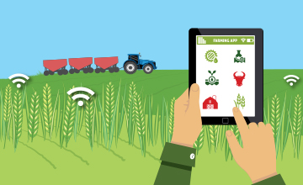
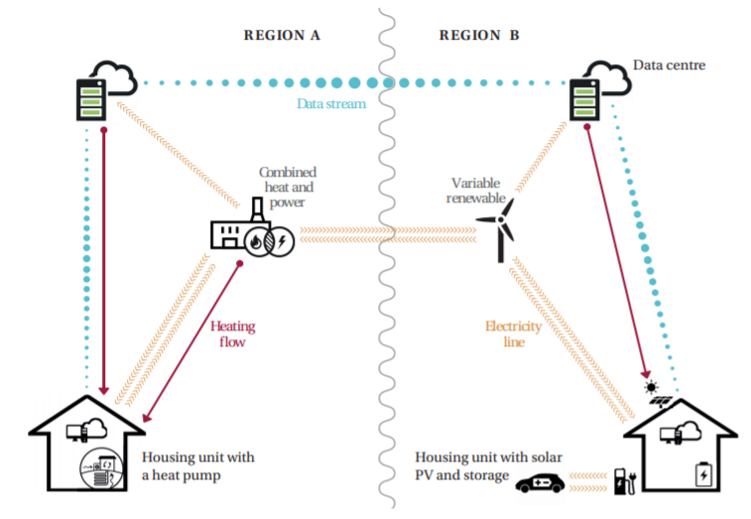
Many ways to use digital technology to reduce environmental footprint
Primary sector
Smart homes
Logistics
Recycling/sorting
Sharing
Remote-work
3D Printing
energy-management

Slide 4
EU cannot compete on energy and ressource endowment
Production factors
 | Arable Land (hectaress) per Capita | Energy production (toe) per capita | Innovation (Triadic) patents per thousand capita | Net non-energy materials imports in USD per capita | Capital stock per capita | Labour Nominal wages per capita in USD
United States | .47 | 6.7 | 45 | -10 | .16 | 3700
EU | .21 | 3.1 | 26 | 35 | .17 | 3000
India | .12 | .65 | .3 | 5 | .016 | 13
China | .09 | 2.1 | .02 | 65 | .05 | 77
source | World Bank 2016 | Eurostat, IEA 2016 | OECD 2015 | UN Comtrade | feenstra | ILO

Slide 5
Different pathways with different factor-combinations are feasible
Example: Recycling
energy intensive pyrolysis
resource intensive “thermal recovery”
labour intensive sorting
data/intelligence-intensive sorting approaches
Europe’s comparative advantage might often lie in more capital/knowledge-intensive solutions

Slide 6
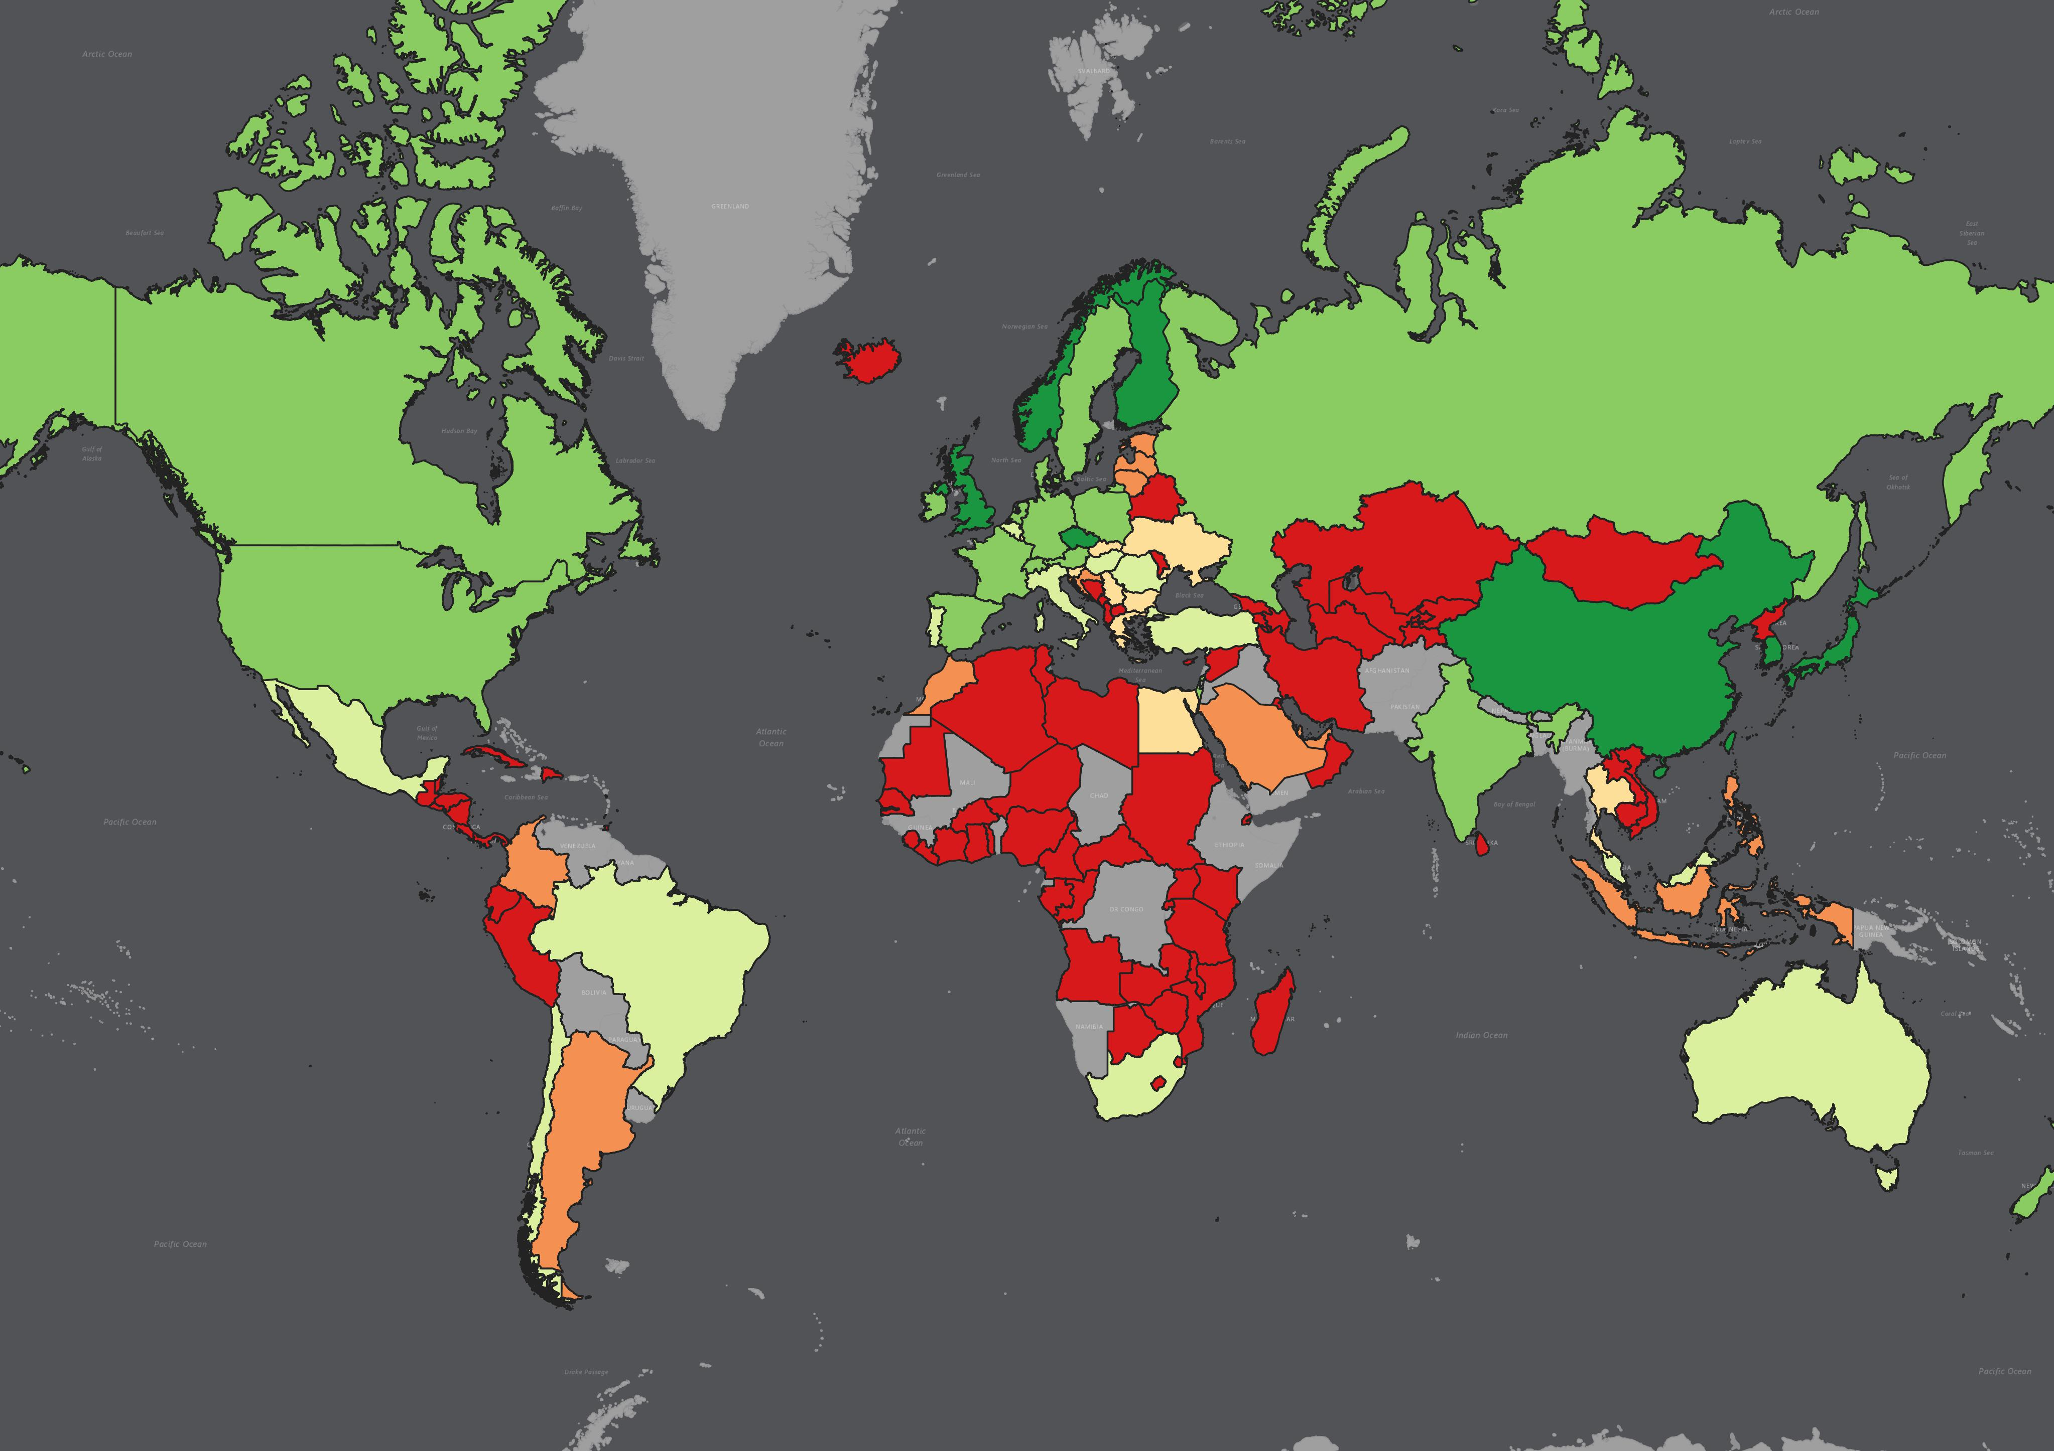
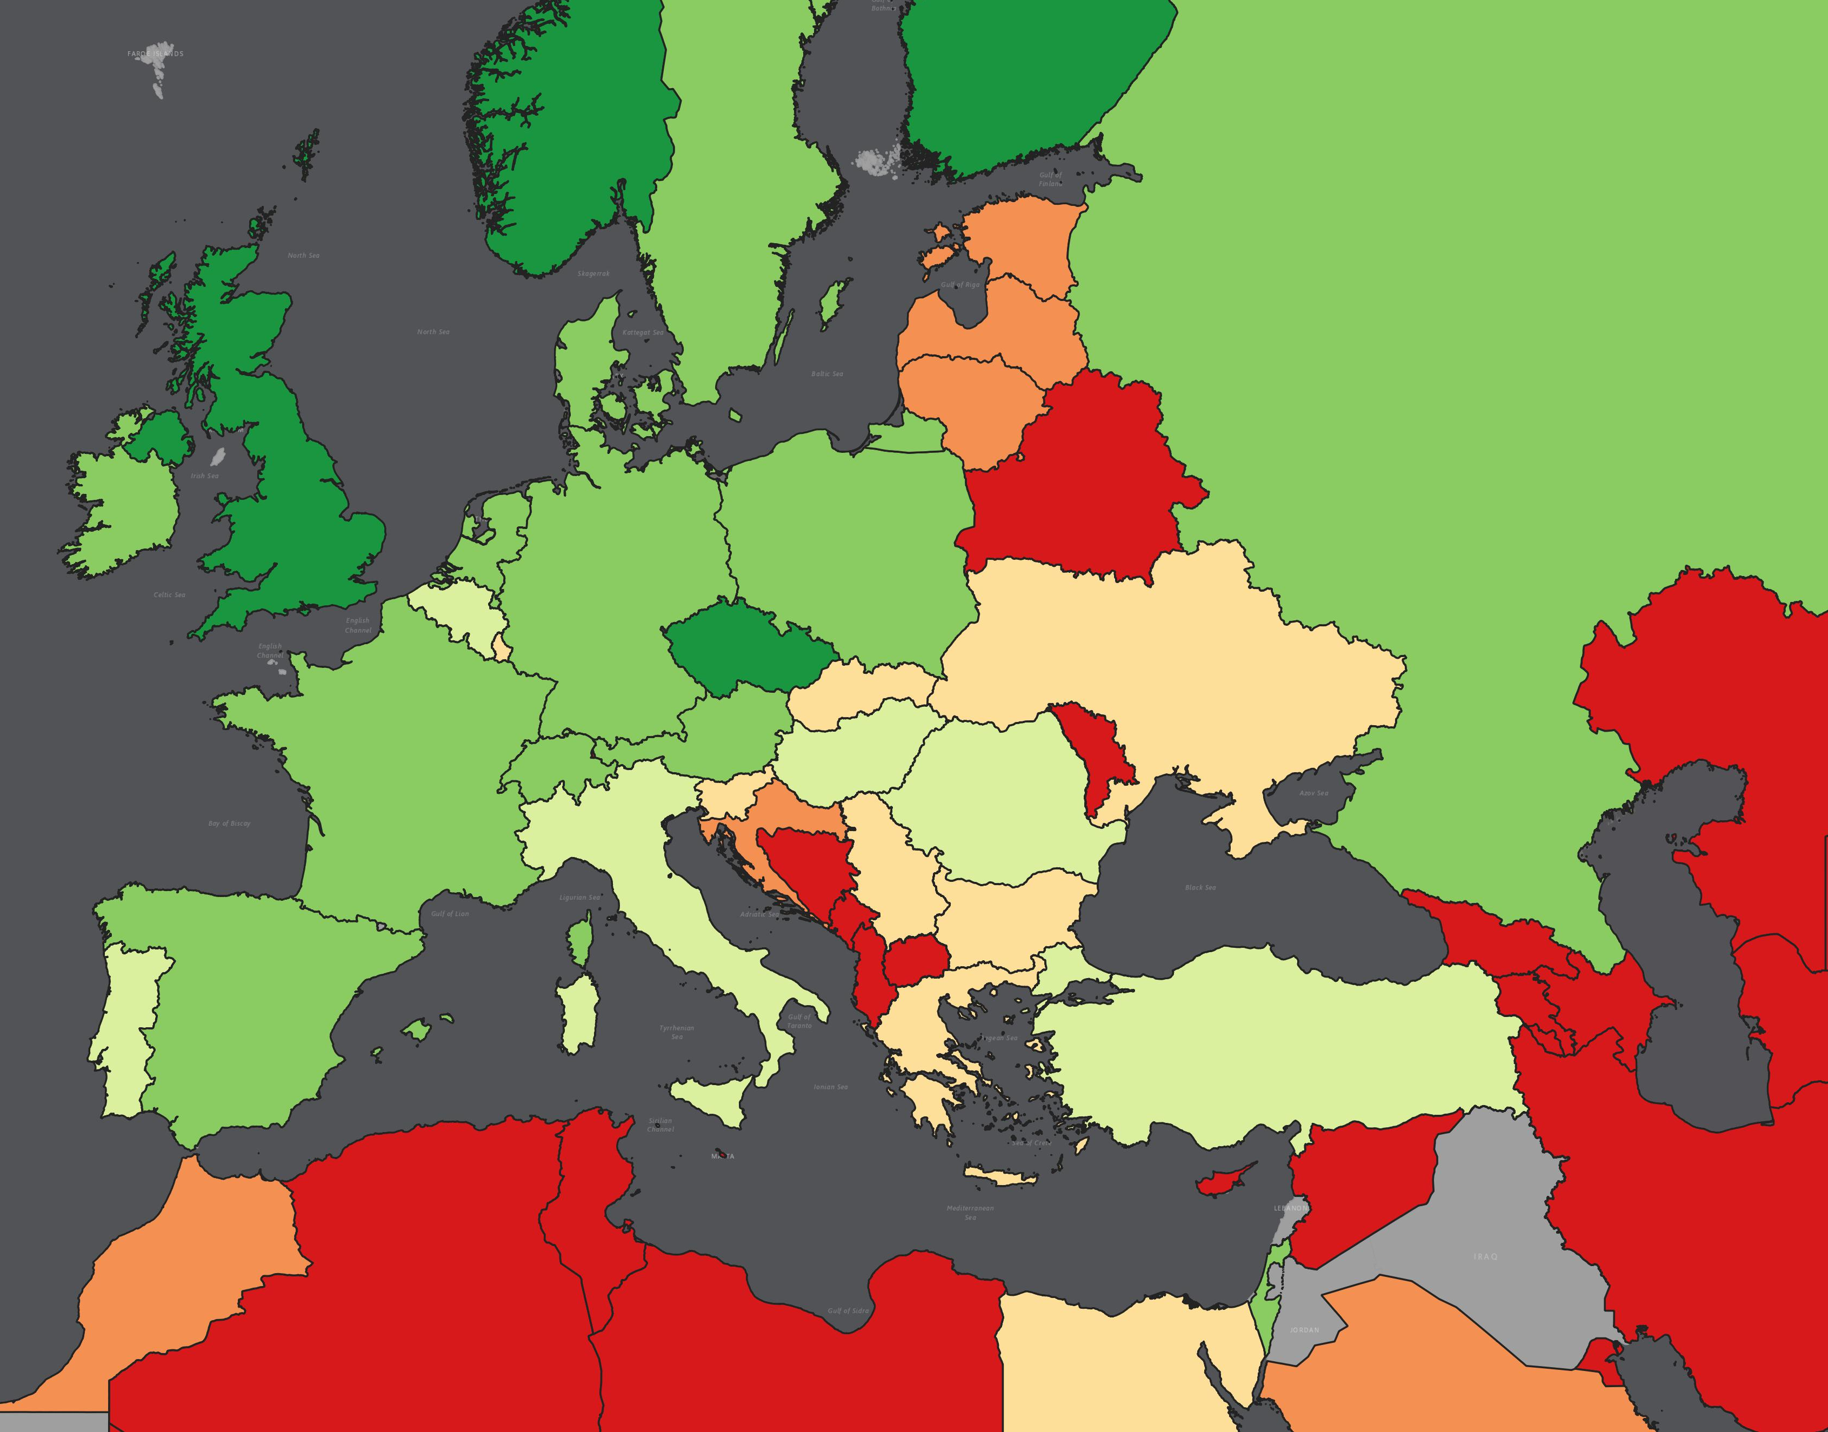
Example: Energy Management
Potential comparative technological advantage
Source: Bruegel based on data from EPO Patstat

Slide 7
Two questions for today
Where could be opportunities for European industry to use digital technology to reduce the environmental footprint?
What policy tools are available to enable European industry to use the identified potential?

