Slide 1
Poland‘s Energy Policy until 2040 and NECP
Dr Aleksandra Gawlikowska-Fyk

Slide 2

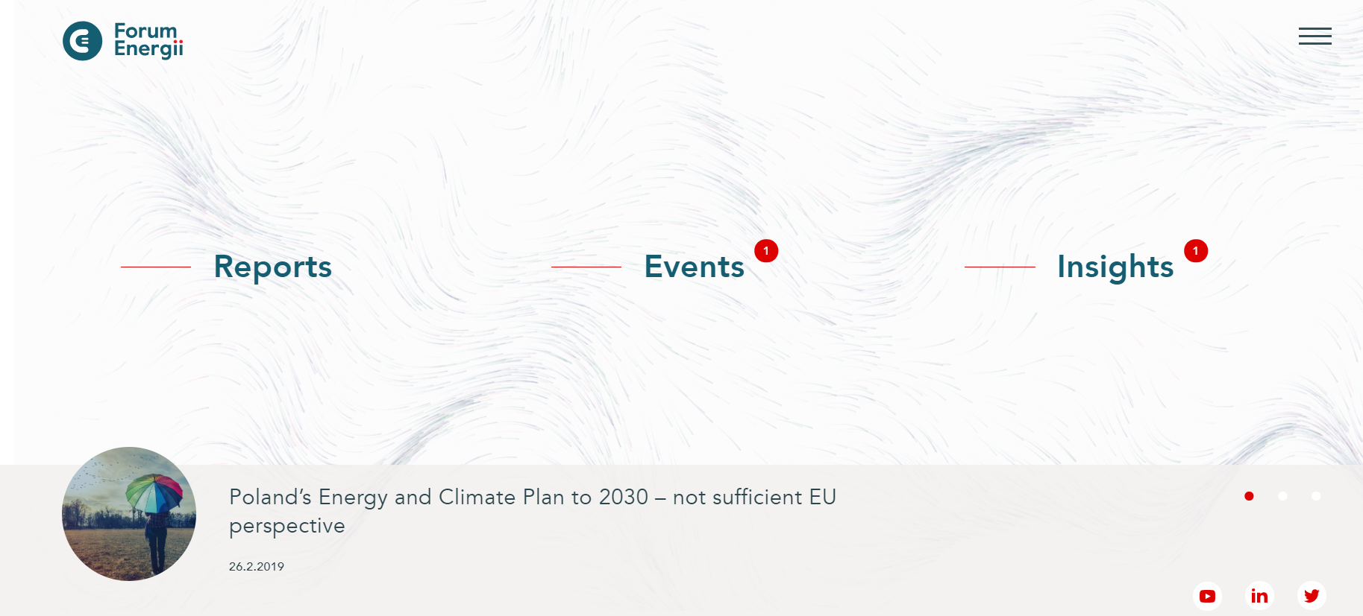

About us
Forum Energii is an independent and non-partisan energy think tank.
We are focused on forging the foundation for a clean, innovative, safe and efficient energy sector based on data and analysis.
Our mission is to support Poland's implementation of energy and climate goals for 2020 and 2030.

Slide 3
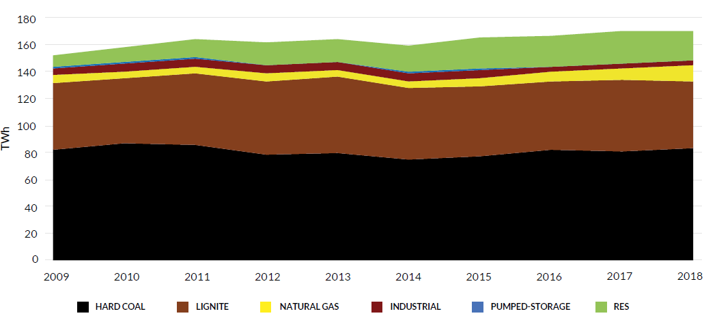
Electricity production in the last decade

Slide 4
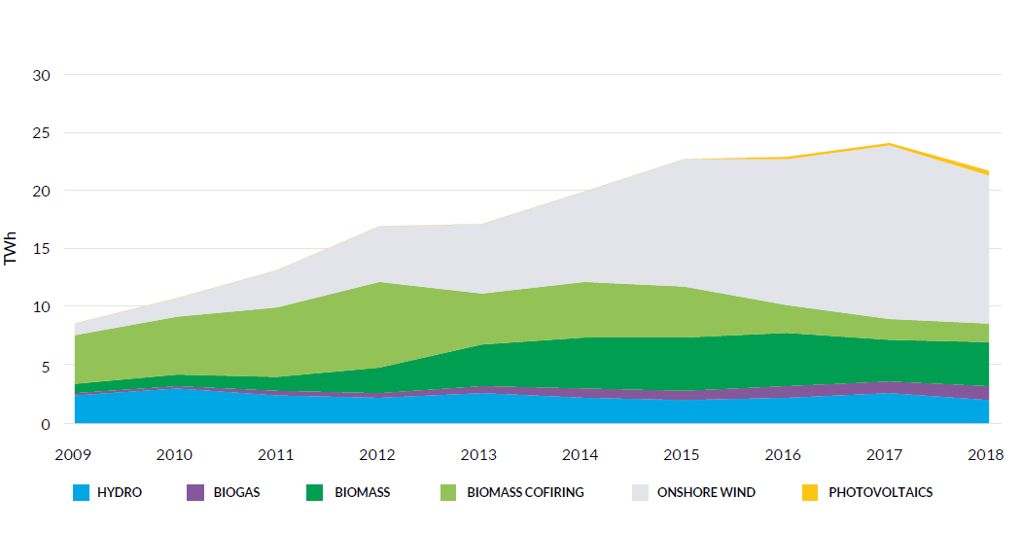
Changes in RES electricity production

Slide 5
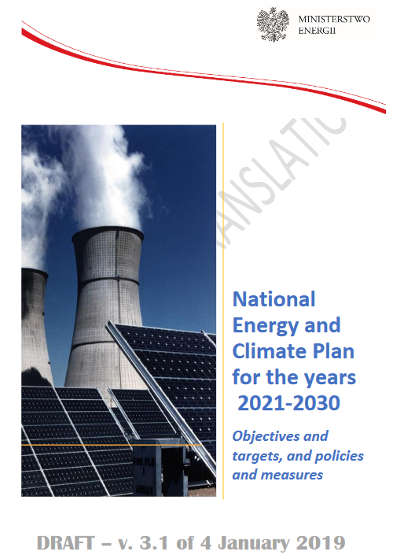
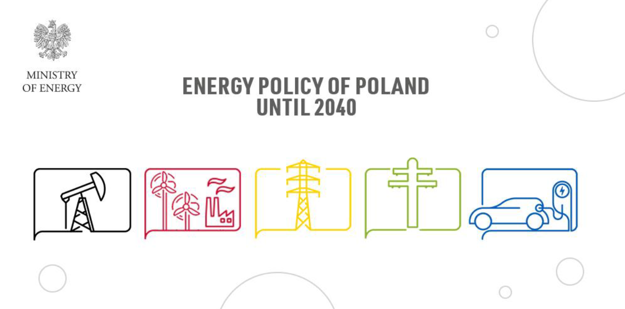
Two strategic documents

Slide 6
Draft Energy Policy – objectives and indicators

Slide 7
Energy Policy – production

Slide 8
Energy Policy – CO₂ emissions

Slide 9
Conclusions
  Insufficient reference to EU targets (2030) & regulations (Winter Package)
  Lack of costs optimization
  High rate of electricity demand growth (does not result from electrification of heating and transport)
  Lack of strategy regarding electricity imports
  Lack of a reliable fuel balance
  No reference to the functioning of the energy market

Slide 10
Risks
  Delays in or (rather) lack of commissioning of nuclear power plants → adequacy problems after lignite phase out
  Costs and wholesale prices → such electricity mix does not minimise the costs; too high a correlation with CO₂ prices
  Unlimited imports of electricity
  Imports of coal?

Slide 11
Thank you!
Dr Aleksandra Gawlikowska-Fyk
Head of the Power Project aleksandra.gawlikowska-fyk@forum-energii.eu

