Slide 1
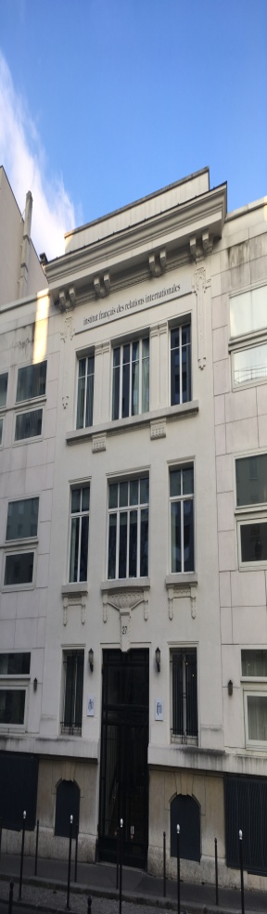
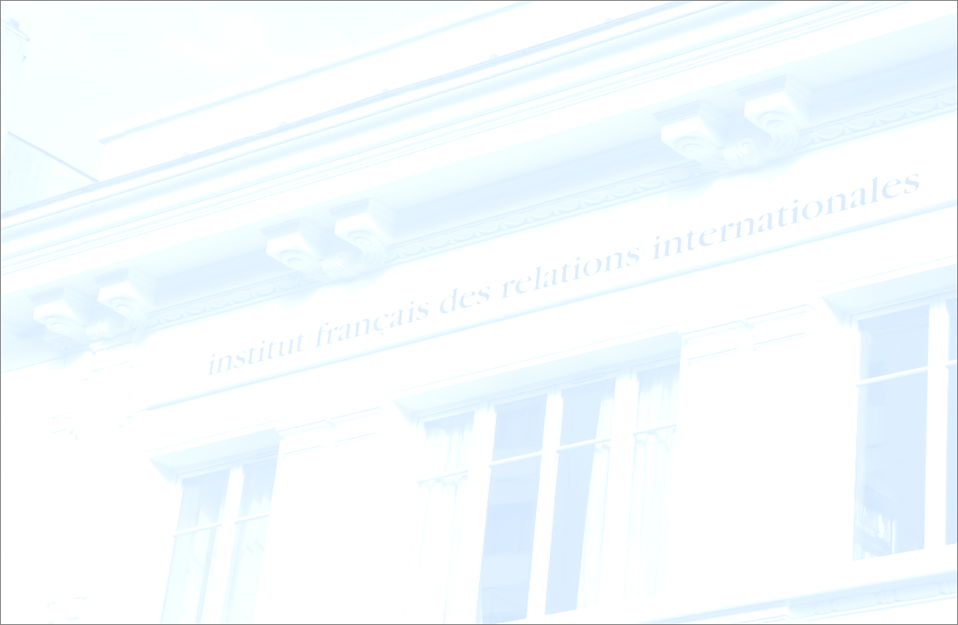





The French Energy & Climate Strategy and the Future Role of Nuclear Electricity
Carole Mathieu, Ifri Centre for Energy
Bruegel, 15/05/19
1
Notes:
1

Slide 2
Targeting net zero emissions by 2050
French energy consumption by vector, 2015, 2030 and 2050
Source: Draft SNBC
Carbon neutrality implies a very sharp drop in energy consumption following strengthened EE efforts and a supply mainly composed carbon-free electricity, bioenergies and renewable heat
2
Notes:
2
(47.5% of total installed capacity)

Slide 3
Policy actions to reduce final energy consumption in all sectors (by 2028)
Final energy consumption, 2010-2028
MAIN POLICY MEASURES
Carbon pricing (€86/t in 2022)
2.5 million homes renovated by 2023
Public support for high-performing heating systems
White certificate scheme beyond 2021
EU emission standards in the automotive sector + support to car-sharing
Source: Draft PPE
Final energy consumption to decrease by 7% in 2023 and by 14% in 2028 compared to 2012 levels
3
Notes:
3
(47.5% of total installed capacity)

Slide 4
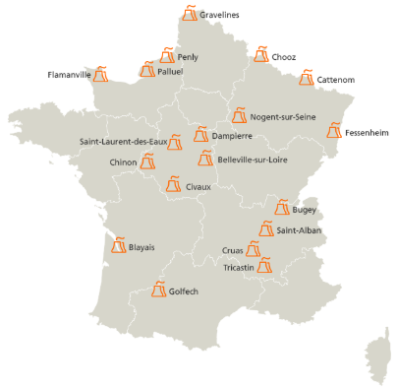
Nuclear, the backbone of the French electricity system
French electricity production by source, 2018
Location of the 58 operational nuclear reactors
Source: RTE, bilan 2018
Source: EDF, 2019
63.1 GW installed nuclear capacity
393.2 TWh of nuclear electricity produced in 2018
≥90% decarbonized electricity mix
Retail electricity prices about 15% lower than EU average for households (€0.1754/ KWh)
Capacity | Number of reactors
1450 MW | 4
1300 MW | 20
900 MW | 34
1650 MW (under construction) | 1 (mid-2020)
4
Notes:
4
(47.5% of total installed capacity)

Slide 5
Towards a more diversified electricity mix
50% nuclear target shifted to 2035 ➔climate protection comes before the diversification goal
CAPACITY CLOSURES
Fessenheim (2 reactors) to be closed by Spring 2020
All four coal stations (35% of CO₂ emissions from the power sector) to be closed by 2022, unless adequacy issues
2 nuclear reactors to be closed in 2027-2028
Possibly 2 additional reactors to be closed in 2025-2026 (decision in 2023) IF the regional context is favorable
50% nuclear by 2035 ➔ closing 14 reactors in total
Expected changes in gross electricity production
Source: Draft PPE
5
Notes:
5
Official target for renewables: to reach 40% of total electricity production by 2030 (compared to 17% today)
2023: 27% renewables / 67% nuclear
2028: 33-36% renewables / 59-61% nuclear
Complementarity with renewables: 2/3rd of existing French reactors can go from 100 to 20% capacity in 30 minutes

Slide 6
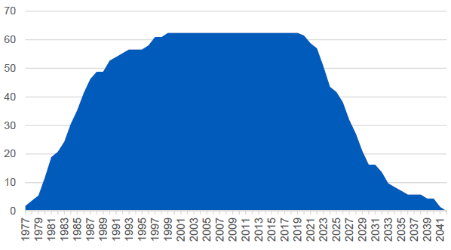
Extending the technical life-time of reactors, while planning a gradual decommissioning
On average, French reactors are 31 years old
75% of all French reactors will reach the 40 years threshold by 2030
« GRAND CARENAGE » : Investment programme to modernize existing reactors and ensure a safe and high-performing operation beyond 40 years, with the approval of the Nuclear Safety Agency
  €4bn/yr over 2014-2025
  4th ten-year inspection to start with the 900MW reactors, in 2019 for Tricastin
French nuclear capacity (GW) assuming a 40 year technical lifetime
Source: EDF
Assuming a max. 60 yr technical life-time, 50GW of nuclear capacity will have to be put offline by 2050 ➔ a gradual phase out is necessary to avoid a cliff-edge effect
6
Notes:
6
All reactors have been built over 25 years

Slide 7
Building new reactors : a topic for the next Presidential campaign
Beyond 2030-2035, new decarbonized electricity production means will have to be built:
  Renewables + storage and other decabonized flexibility sources ?
  Renewables + new nuclear ?
Keeping the nuclear option « open », what implications?
  Maintaining the industrial capacity after EPR I
  Long delivery time: close to 10 years needed between the decision and the commissioning of the first pair of reactors, then 1 reactor could be commissioned every 1-2 years (EDF)
By mid-2021, the government will gather « all elements needed » to take an informed decision on the need to build new nuclear reactors
7
Notes:
7

Slide 8
Key factors weighing in future decision
Commissioning of Flamanville EPR by mid-2020 / implementation of Hinkley Point C project
Ability of the French nuclear industry to define a competitive « EPR2 » offer & to define a robust waste management strategy
Industrial sovereignty dimension:
  Nuclear: French industry spanning the full range of nuclear activities, 220 000 jobs, mostly highly-qualified
  Nuclear exports / Sino-Russian duopoly / non-proliferation strategy
Regional / EU dimension:
  Influence of neighbouring countries’ experience, including the success of Germany’s Energiewende and coal phase out plan
  Approval by the EU Commission will be necessary for a new remuneration / risk-sharing scheme
  EU debate over carbon neutrality by 2050
8
Notes:
8
Standardization of key components, digital engineering, simplified design to improve constructability.
Existing nuclear waste storage sites have been designed for the existing fleet, with the assumption that reactors will have an operational life of 50 years.

Slide 9


Centre Énergie – Centre for Energy
Carole Mathieu, Head of EU Energy & Climate Policies
mathieu@ifri.org
27, rue de la Procession, 75740 PARIS CEDEX 15
Tél. +33 (0) 1 40 61 60 00 • Fax : +33 (0) 1 40 61 60 60
www.ifri.org
9
Notes:
9

