Slide 1
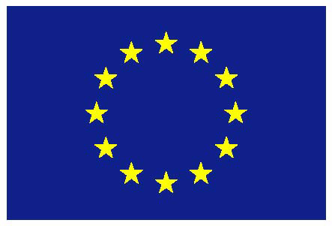
The Future of the EU Budget
Margit Schratzenstaller
Austrian Institute of Economic Research WIFO
Bruegel, Brussels, November 15th, 2016
The project is funded by the European Union’s Horizon 2020 research and innovation programme 2014-2018, grant agreement No. FairTax 649439

Slide 2
The project in brief
Project facts
Akronym: FairTax
Duration: 4 years, from 2015-2019
Partners: 11
Coordinator: Prof. Åsa Gunnarsson, Umeå University, Sweden
In line with long-term EU strategies and challenges:
EU2020 strategy; renewed EU Sustainable Development Strategy; Sustainable Development Goals; Paris Agreement…
H2020-Societal Challenges (EURO-SOCIETY-2014. OVERCOMING THE CRISIS: NEW IDEAS, STRATEGIES AND GOVERNANCE STRUCTURES FOR EUROPE)

Slide 3
Objectives
Options for expanding EU legislative competences, or other governance mechanisms, enabling the EU to effectively harmonise and coordinate Member States' tax and social policies.
Reform options for state-level coordination to create fairer, more stable and sustainable tax and social policy regimes.
Strategies for the increased effectiveness and harmonisation of tax administration and compliance structures within the EU and non-EU areas.
Recommendations for true own-source EU revenues.
.

Slide 4
FairTax work packages and research topics
Critical Assessment of EC Jurisdiction over Tax Policy Norms: Aspirations,Obligations, and Barriers
Harmonising EU Tax Bases, Tax Rates, and Tax Mixes: Growth, Fairness, and Sustainability
Gender Equality, Income Inequalities, and Coordinating the Individualisation of Tax-Benefit Unit Laws in EU Fiscal Policy
European Pension Policies and Intergenerational Fiscal Sustainability, Fairness, and Consolidation
Increasing Sustainability and Competitiveness by Harmonising and Coordinating EU Corporate Tax Bases
Co-producing Tax Compliance: Tax Agency Mobilisation of Taxpayers, Businesses, and Third Parties (Nordic Countries)
Tax Risk Management and Large Businesses: Cooperative Compliance Initiatives and the Role of Tax Advisors in Corporate Tax Policy and Practice (UK/Ireland and the Nordic Countries)
Sustainability-oriented Options for EU Own Resources

Slide 5
FairTax partners
(Coordinator) Åsa Gunnarsson, Umeå University Sweden
Lotta Björklund Larsen, Linköping University Sweden
Benedicte Brögger, Handelshöyskolen BI Norway
Karen Boll, Copenhagen Business School Denmark
Ann Mumford, King’s College London UK
Lynne Oates, University of Exeter UK
Emer Mulligan, National University of Ireland, Galway Ireland
Margit Schratzenstaller, WIFO Austria
Dana Nerudová, Mendel University Czech Republic
Kathleen Lahey, Queen’s University at Kingston Canada
Leonel Cesarino Pessôa, Getulio Vargas Foundation Law School Brazil

Slide 6
FairTax Work Package 8: Sustainability-oriented future EU funding
EU current system of own resources: historical development and criticism
Identification of fundamental pros and cons of tax-based own resources as an alternative own resource
Widening the perspective by innovative comprehensive concept of sustainability-oriented taxation
Establishing evaluation criteria capturing the four dimensions of sustainability relevant for taxation
Development and analysis/evaluation of candidates for sustainability-oriented tax based own resources

Slide 7
Current EU system of own resources – main problems
Decreasing and very low financial autonomy of EU
EU budget mainly financed by direct contributions from Member States – juste-retour-debate
Complicated and in-transparent system
Financial burden not distributed “fairly” across MS
System of own resources does not contribute to central EU objectives: “smart, sustainable, inclusive growth” according to Europe 2020 strategy => tax-based own resources as a remedy?

Slide 8
Pros and cons of EU taxes (1)
EU taxes as automatic stabilizers? => but: EU budget too small
EU taxes to establish fiscal equivalence? => may indeed support provision of optimal level of European public goods
EU taxes to increase reliability/stability of revenues and common debt? => not necessarily

Slide 9
Pros and cons of EU taxes (2)
EU taxes to increase accountability and legitimacy? => possible through some (not all) EU tax candidates only => would weaken the power of other sanctioning tools => evidence that EU taxes would enhance citizen involvement is missing
EU taxes to increase transparency? => not necessarily

Slide 10
Pros and cons of EU taxes (3)
EU taxes against net position / juste-retour thinking? => yes, if national shares in overall revenues cannot be determined and if EU taxes are “additional”
EU taxes may contribute to central EU objectives: “smart, sustainable, inclusive growth” according to Europe 2020 strategy; SDG…

Slide 11
Rationale for sustainability-oriented tax-based own resources
Current system of EU own resources does not contribute to central EU objectives: “smart, sustainable, inclusive growth” according to Europe 2020 strategy; SDG…
Sustainability-oriented tax-based own resources may reduce/ compensate for sustainability gaps in EU Member States’ tax regimes

Slide 12
Sustainability gaps in taxation in EU
High and increasing weight of labour taxes
average 50% of overall tax revenues in EU15 (EU28)
Decreasing progressivity of tax systems
increasing weight of VAT means increasing regressive distributional effects
redistributive power of taxation has weakened
Decreasing importance of Pigovian taxes
primary objective of environmental taxes is generation of additional revenues
taxes on financial sector play limited role
Intense tax competition
Corporate taxation, environmental taxation
Tax compliance and tax fraud

Slide 13
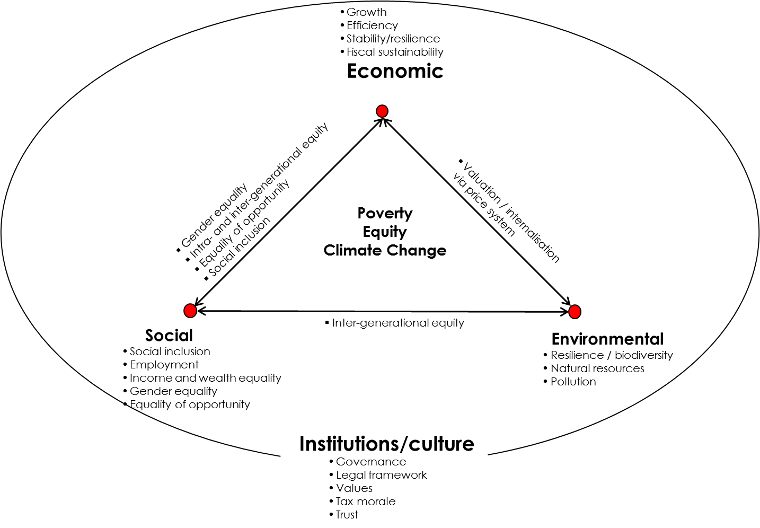
Sustainability gaps in taxation in EU

Slide 14
Why use certain taxes as EU own resources?
Enforcement problems/ downward tax competition at national level due to mobility of tax subjects/ tax bases
Due to cross-border externalities national tax rates may be set at suboptimal levels
Unilateral tax measures may reduce pressure on other countries to implement unilateral tax measures themselves as they can act as free-riders
Tax revenues are not clearly attributable to individual countries => assignment of revenues to EU level => to fund EU expenditures => juste-retour problem!

Slide 15
FairTax sustainability-oriented candidates for tax-based EU own resources
CC(C)TB
Financial Transactions Tax
Carbon-based Flight Ticket Tax
Carbon Tax
Tax on Nuclear Power
Wealth Tax

Slide 16
Flight ticket tax (1)
Group of European countries which gave up their ticket taxes almost as large as group of countries still having them
Constant discussion and downward pressure on existing flight ticket taxes
Tax rates rather low and no systematic link to carbon intensity of flights
Limited experience corroborates theoretical expectation that due to (alleged) tax competition aviation taxes cannot be implemented effectively at national level => „stuck to the bottom“ rather than „race to the bottom“

Slide 17
Flight ticket tax (2)
EU revenues for three different scenarios
Low-tax scenario (25 €/tonne CO₂): € 3.9 billion
Medium-tax scenario (30 €/tonne CO₂): € 4.6 billion
High-tax scenario (35 €/tonne CO₂): € 5.4 billion

Slide 18
Flight ticket tax (3)
International approach necessary due to cross-border nature of externalities and (alleged) tax competition
Revenues from taxing international flights not attributable to individual Member States
If introduced in 2014, passenger numbers would not have increased by 4% but would have remained constant => potential to at least dampen massive annual air passenger growth
Limited revenue potential, but stable revenue source
Distributional effects: limited empirical evidence points at rather progressive effects
(EU-ETS and current problems)

Slide 19
Key arguments for tax-based EU own resources
Contribution of sustainability-oriented tax-based own resources to central EU strategies (EU 2020 strategy, SDG, Paris Agreement…) and “Budgeting for Results”
EU taxes may weaken juste-retour thinking:
Non-attributability of revenues to individual MS
“Additionality” of suggested candidates for tax-based own resources – but within a fiscally neutral approach (tax-based own resources as alternative, not as additional own resources)
Strengthening fiscal coherence
Implementation possible within current legal/ constitutional framework

Slide 20
Key issues and problems
Implementation within current legal framework (=> remittance system)
Long-term sufficiency of effective corrective carbon taxes
Stronger sustainability-orientation of EU expenditures as a key prerequisite for realistic chances of implementation (otherwise tax-based own resources might even increase resistance against further European integration)

Slide 21
Corner stones of sustainability-oriented EU budget
Strengthen second pillar of CAP
Increase share of R&D expenditures in general and strengthen sustainability-oriented R&D
Strengthen sustainability-oriented focus in cohesion policy
Pro-active migration policy

Slide 22
FairTax Publications
Alexander Krenek, Margit Schratzenstaller, Sustainability-oriented EU Taxes: The Example of a European Carbon-based Flight Ticket Tax, FairTax Working Paper No. 1, 2016
Margit Schratzenstaller, Alexander Krenek, Danuse Nerudová, Marian Dobranschi, EU Taxes as Genuine Own Resource to Finance the EU Budget – Pros, Cons and Sustainability-oriented Criteria to Evaluate Potential Tax Candidates, FairTax Working Paper No. 3, 2016

