Slide 1
Principles of Sustainable Finance
Dirk Schoenmaker, Erasmus University and Bruegel
30 April 2019, Bruegel

Slide 2
Agenda
Sustainability journey:
Part 1) why: sustainability challenges
Part 2) what: sustainable companies
Part 3) how: financing of sustainable companies
Part 4) transition to a sustainable economy
Key message:
From maximising profit F
To maximising integrated value I = F + S + E

Slide 3
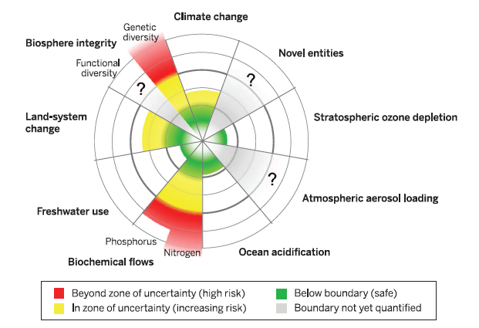
Planetary boundaries framework

Slide 4
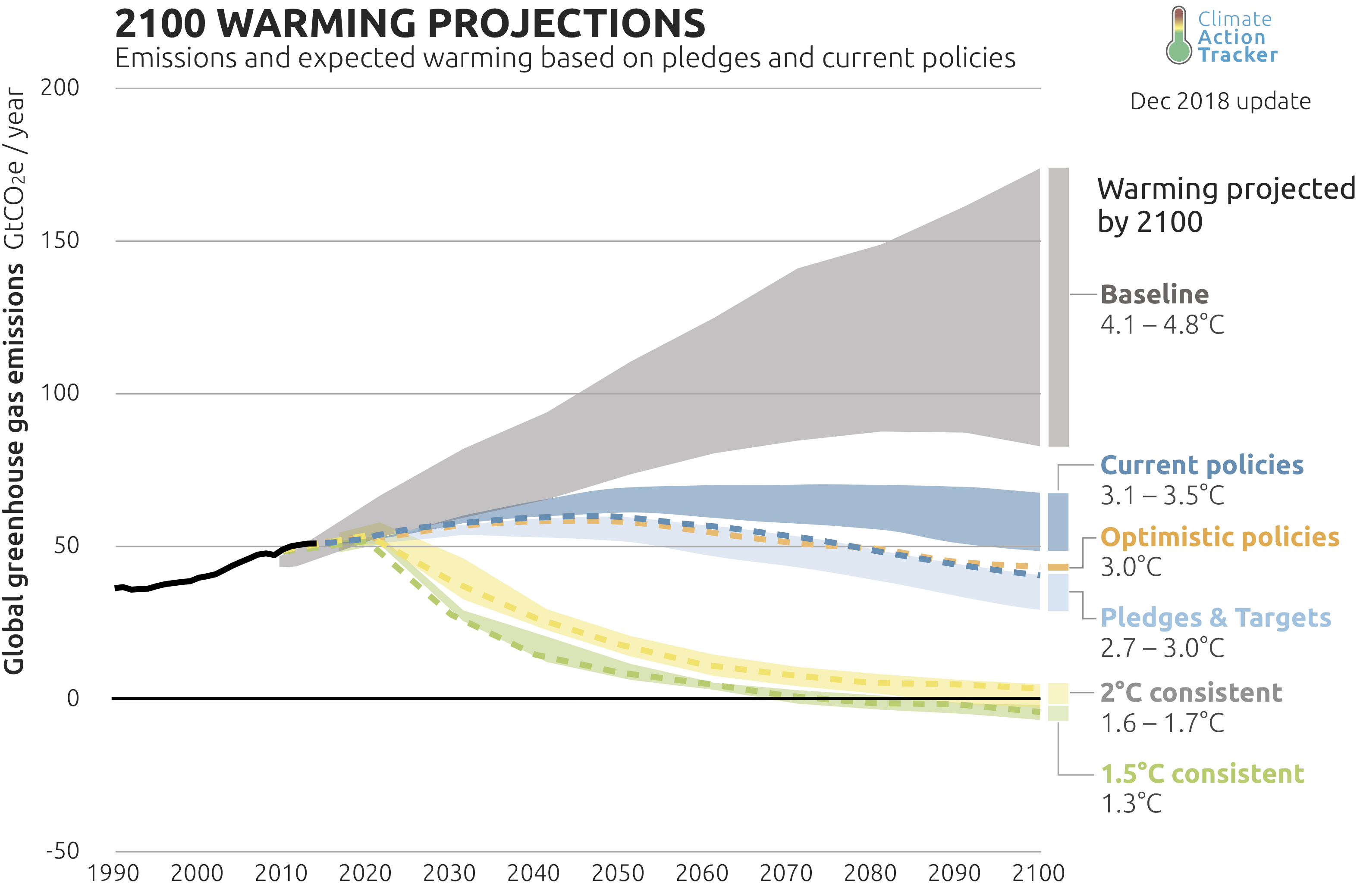
Climate policy gap

Slide 5
Social foundations
Food security (no hunger)
Adequate income (no poverty with income of less than $3.10 a day)
Access to health care
Access to water
Access to energy and clean cooking facilities
Education
Decent work (living wage)
Gender equality and social equity
Political voice: right of people to be involved in decisions that affect them
Many people live below these social foundations

Slide 6
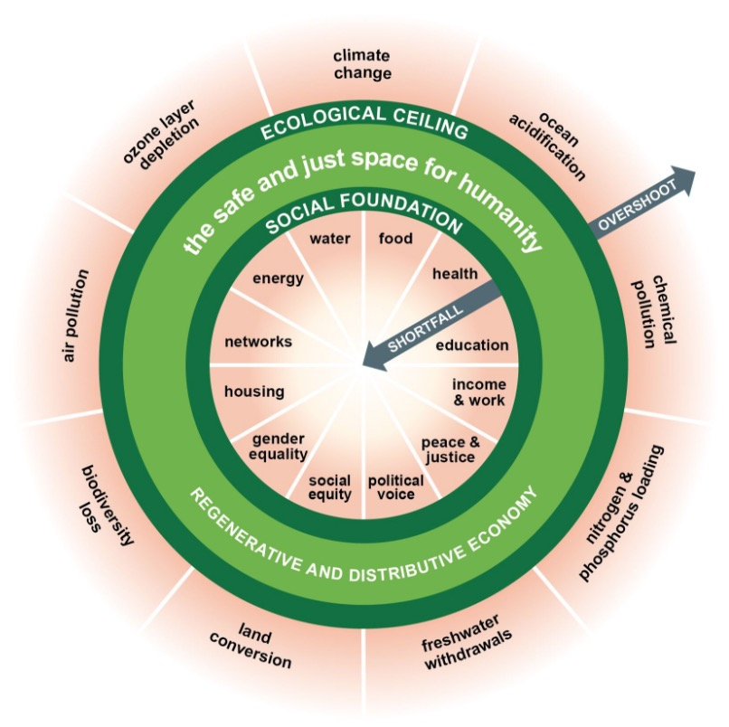
The Doughnut of Kate Raworth

Slide 7
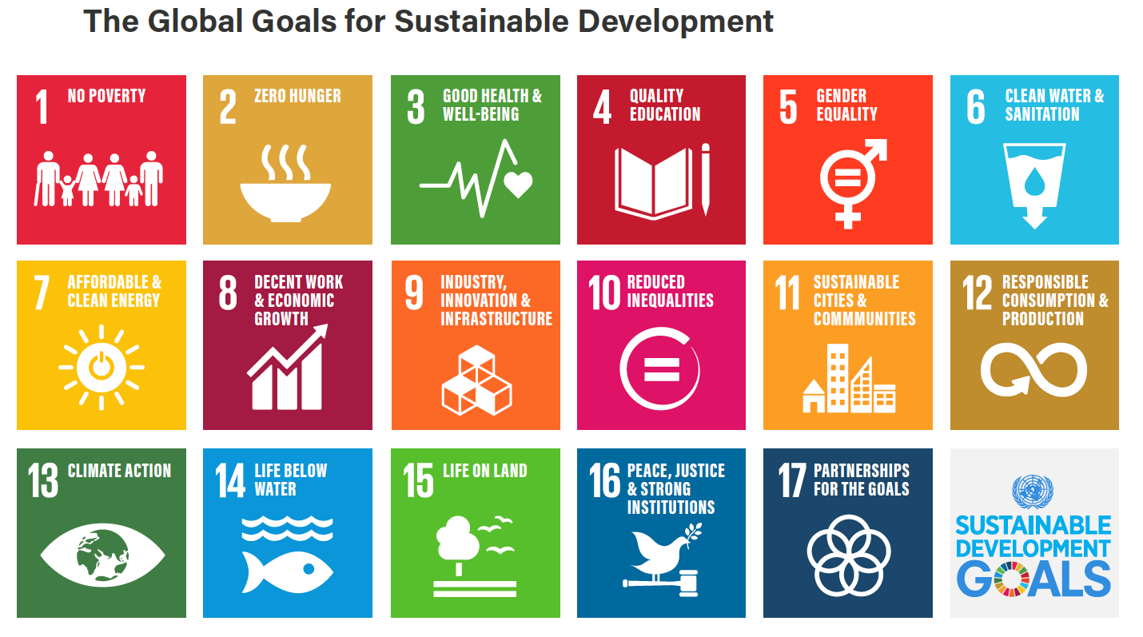
Global goals for sustainable development

Slide 8
How to make it operational?
Example: Living wage
Linked to SDG 8 - decent work and income
Provides a family with the means to buy life’s essentials
Potential impact of living wage on other SDGs

Slide 9
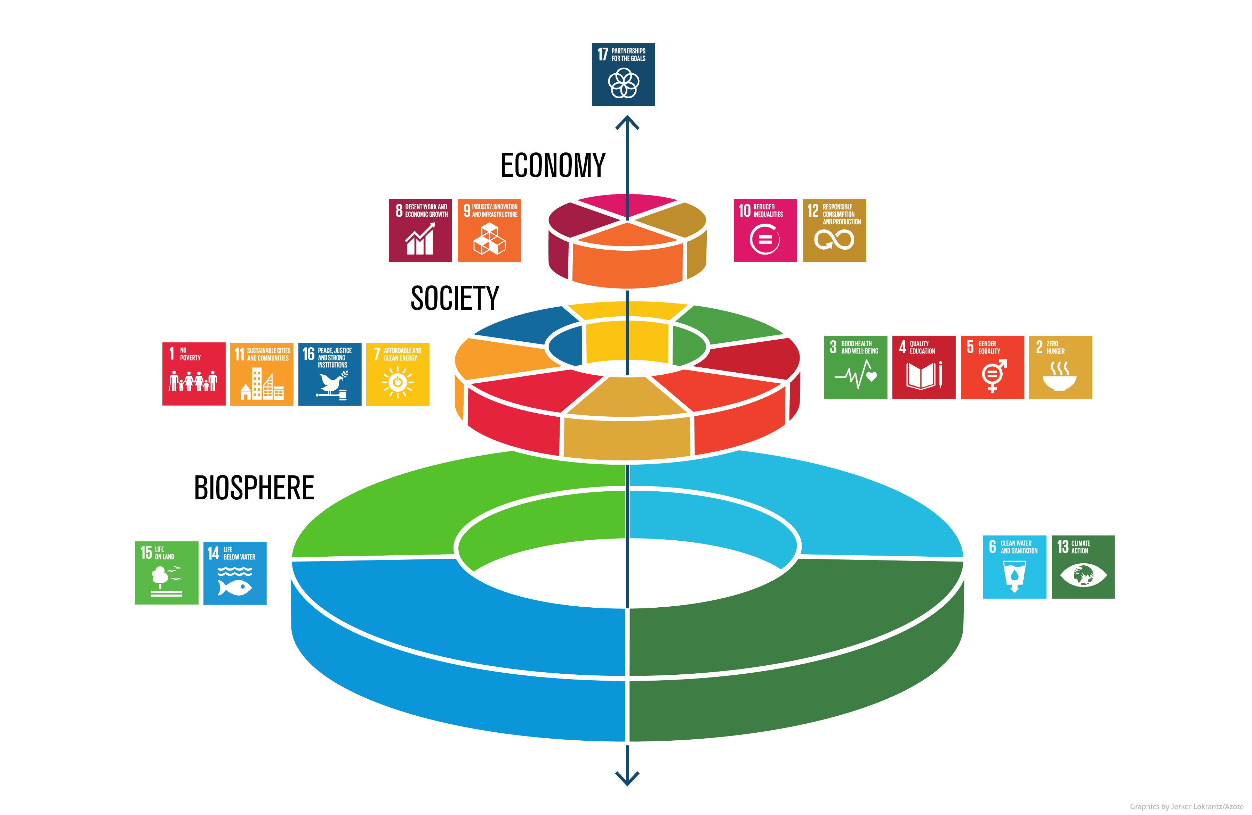

Slide 10
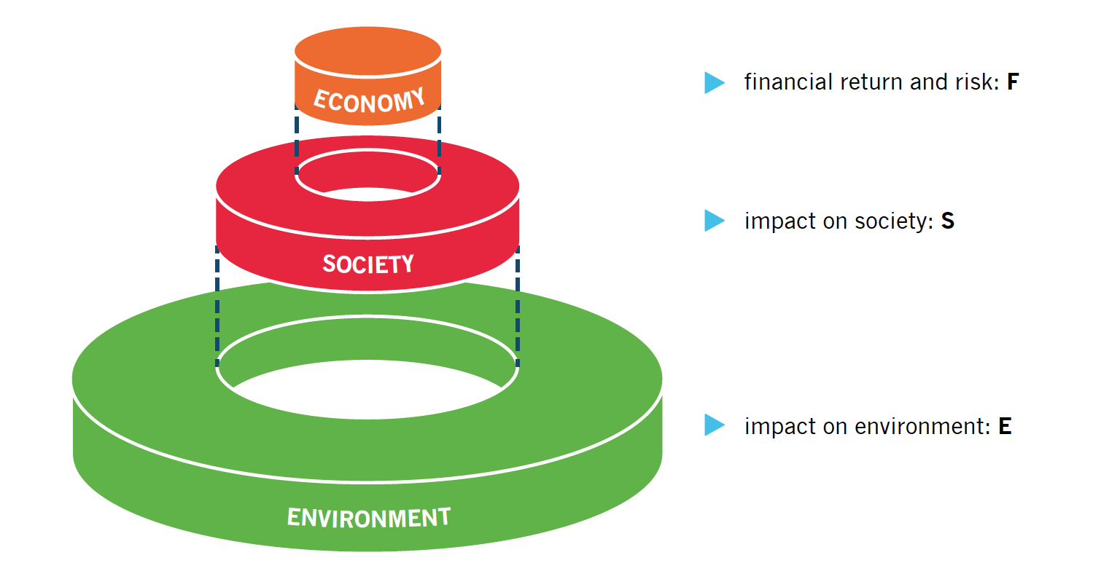
Managing sustainable development

Slide 11
Perspectives on externalities
Human rights advocate: ensuring every person’s claim to life’s essentials
Economist:
a public good which is not priced
Ecologist:
need to operate within planetary boundaries
F
S
E
Sustainable development: I = F + S + E

Slide 12
Principles of sustainable finance

Slide 13
Blind spots of the financial system
Integrated value of tobacco companies:
+ Profit
+ Employment
- Premature death
- Extra costs healthcare
Net negative
Financial system only notices:
+ Profit
Net positive
Notes:
Ch2
Veel maatschappelijke baten en lasten zijn ‘externaliteiten’ en dus financieel niet relevant
Andere uitkomst = andere beslissing

Slide 14
Why integrate sustainability?
Why would financials and corporates look at sustainability?
Anticipation of regulation / taxation (e.g. carbon tax)
Reputation – pressure from NGOs / consumers
Future-proof: transition to SDGs by 2030
Moral responsibility of financials and corporates

Slide 15
Active investment approaches
Institutional investors can realise LT returns by investing in and engaging with companies that pursue long-term value creation
Requires fundamental analysis of companies’ business models
ESG ratings have limits by design
Aim: to uncover companies’ social (S) + environmental (E) value, alongside financial (F) value
Calculate integrated value: I = F + S + E

Slide 16
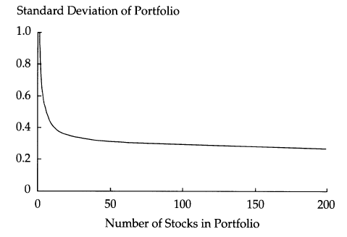
From extremely diversified to concentrated portfolios
Pension funds may hold thousands of different securities
Serious engagement not feasible…
…, while not necessary from a diversification perspective….

Slide 17
Virtuous cycle of sustainable investing
Fundamental analysis
Selection in concentrated portfolio
Deep engagement

Slide 18
And sustainable banking
S and E factors
Factors influencing creditworthiness
Credit risk indicators
Examples of sectoral lending policies
Westpac : zero net deforestation
Rabobank: food and agri standards
New approaches with focus on transition towards 2⁰C scenario
ING: Terra – look at technology scenarios for each industry
Grant loans which are consistent with projected installed base

Slide 19
Conclusions
Long-term value creation to achieve SDGs
From narrow F dimension
To integrated value: I = F + S + E
Finance is about anticipating events and pricing them in today
Finance contributes to swift(er) transition

