Slide 1
National electricity mixes
Georg Zachmann

Slide 2
Electricity-mix outlook: 2017 - 2030
Carbon
Germany | 2017 | 2030
Carbon | 53% | 35%
Nuclear | 12% | 0%
RES | 35% | 65%
France | 2017 | 2028
Carbon | 11% | 5%
Nuclear | 71% | 59%
RES | 18% | 36%
Poland | 2017 | 2030
Carbon | 85% | 73%
Nuclear | 0% | 0%
RES | 15% | 27%
RES
Nuclear
Source: Eurostat and National Energy and Climate Plans (drafts from December 2018)

Slide 3
EUCO3030 vs. NECP electricity-mix
Fossil Fuel
Germany | 2015 | 2030
Fossil Fuel | 57% | 46%
Nuclear | 15% | 0%
RES | 28% | 54%
France | 2017 | 2030
Fossil Fuel | 6% | 1%
Nuclear | 76% | 60%
RES | 18% | 39%
EUCO3030
Poland | 2017 | 2030
Fossil Fuel | 87% | 69%
Nuclear | 0% | 0%
RES | 13% | 31%
NECP
RES
Nuclear
Source: “Technical report on Member State results of the EUCO policy scenarios”
Notes:
EUCO3030
• At least 40% GHG reduction (wrt 1990);
• 30% RES share in final energy consumption
• 30% primary energy consumption reduction (i.e. achieving 1321 Mtoe in 2030) compared to the PRIMES 2007 baseline (1887 Mtoe in 2030). This equals a reduction of primary energy consumption of 23% compared to historic 2005 primary
2030 climate & energy framework
Key targets for 2030:
At least 40% cuts in greenhouse gas emissions (from 1990 levels)
At least 32% share for renewable energy
At least 32.5% improvement in energy efficiency

Slide 4
Planned electricity exchanges
Germany: Electricity net-exports constant until 2030
Poland: Electricity net-exchange assumed to be zero after 2025
France: no projection of net electricity exchange in PPE/NECP
Notes:
EUCO3030
• At least 40% GHG reduction (wrt 1990);
• 30% RES share in final energy consumption
• 30% primary energy consumption reduction (i.e. achieving 1321 Mtoe in 2030) compared to the PRIMES 2007 baseline (1887 Mtoe in 2030). This equals a reduction of primary energy consumption of 23% compared to historic 2005 primary
2030 climate & energy framework
Key targets for 2030:
At least 40% cuts in greenhouse gas emissions (from 1990 levels)
At least 32% share for renewable energy
At least 32.5% improvement in energy efficiency

Slide 5
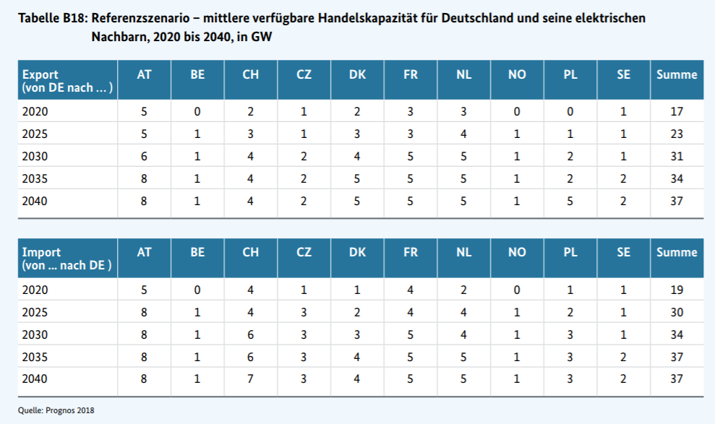
Planned capacity additions by Germany
Notes:
EUCO3030
• At least 40% GHG reduction (wrt 1990);
• 30% RES share in final energy consumption
• 30% primary energy consumption reduction (i.e. achieving 1321 Mtoe in 2030) compared to the PRIMES 2007 baseline (1887 Mtoe in 2030). This equals a reduction of primary energy consumption of 23% compared to historic 2005 primary
2030 climate & energy framework
Key targets for 2030:
At least 40% cuts in greenhouse gas emissions (from 1990 levels)
At least 32% share for renewable energy
At least 32.5% improvement in energy efficiency

