Slide 1

Scaling Up SME Access to Finance
June 21, 2019
Anta Ndoye
Economist
Middle East and Central Asia Department

Slide 2
Outline
Key stylized facts and empirical approach
Macroeconomic benefits and drivers of SME financial inclusion
The role of Fintech
Conclusion

Slide 3
Importance of SMEs in MENA and CCA

Slide 4
7
%
ONLY
OF CREDIT

Slide 5

SME Financial Inclusion Index

Slide 6
Approach used in the SME financial inclusion paper
Focus
Approach
Consultation
  Quantifying potential macroeconomic benefits
  Systematic analysis of drivers of bank credit
  Study role of Fintech and other alternative channels
  Identify policy options to unlock SME financial Inclusion
  Broad range of variables/data sources
  Multiple econometric techniques
  Building on/extending literature on financial inclusion and SMEs
  Country authorities
  Partner international organizations
  Experts and Private sector

Slide 7
Outline
Key stylized facts and empirical approach
Macroeconomic benefits and drivers of SME financial inclusion
The role of Fintech
Conclusion

Slide 8


Economic benefits
Growth Gains of up to
1%

Slide 9

Scaling-up financing to SMEs
ECONOMIC ENABLERS
GOVERNANCE
FINANCIAL INFRASTRUCTURE
ECONOMIC COMPETITION
BUSINESS ENVIRONMENT

Slide 10
Outline
Key stylized facts and empirical approach
Macroeconomic benefits and drivers of SME financial inclusion
The role of Fintech
Conclusion

Slide 11
Promoting new financing channels: the role of Fintech
Enhancing traditional SME finance
Opening new channels for SME finance
Credit information
Crowdfunding (debt, equity)
Real-time credit scores
Peer-to-peer lending
Competition

Slide 12
Outline
Key stylized facts and empirical approach
Macroeconomic benefits and drivers of SME financial inclusion
The role of Fintech
Conclusion

Slide 13
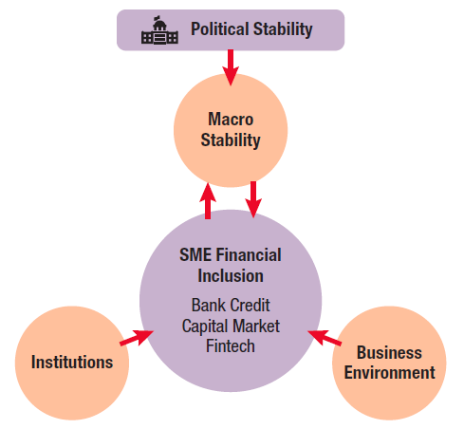








Need for Holistic Policy approaches
Future
Holistic view
Current
Financial inclusion strategies
Past
Direct public interventions

Slide 14
Going forward
Strengthening the Fund’s
advice
Advancing the analytical agenda
Tailored to country needs
Building on international experience
In coordination with key partners
More granular
Exploring “demand-side” factors
Impact assessment of policy approaches
Lessons from country experiences

Slide 15
Granular analysis and country specific advice
Assess the state of SME financial inclusion
SME Financial Inclusion Toolkit
Highlight the main drivers of the SME financial inclusion gap
Identify the key policy priorities to scale up SME access to finance

Slide 16
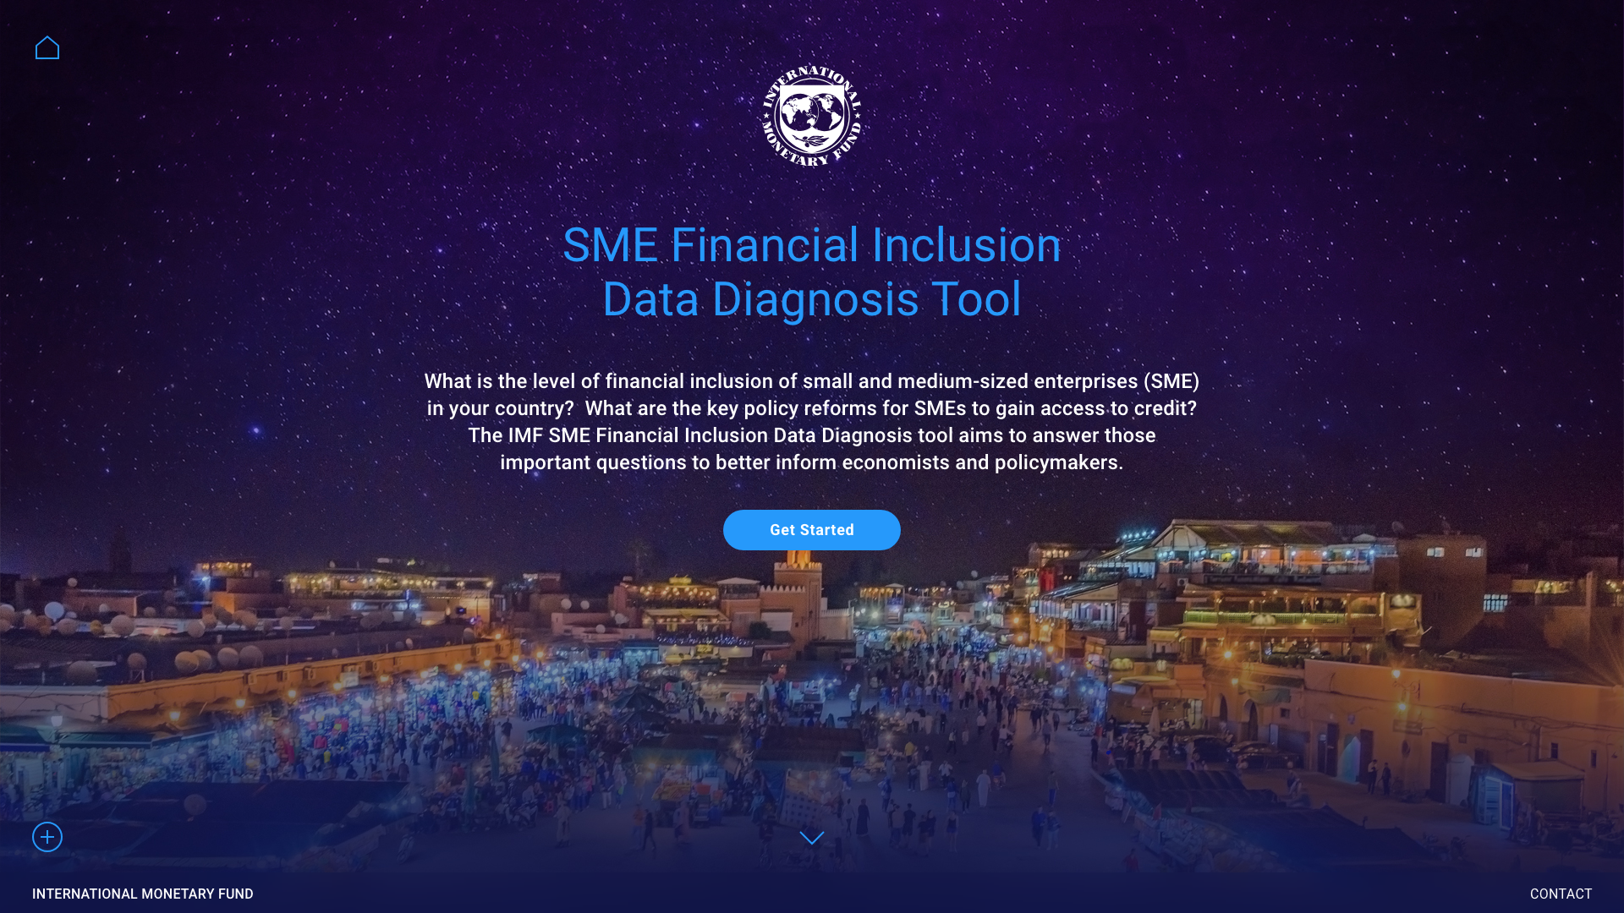

Slide 17

