Slide 1
Sound at last?
Assessing a decade of financial regulation
RESOLVING Too Big To Fail

Slide 2
Bailout: The option that was just too easy
The alternative was a disorderly Bail-in
“haircuts send a destabilizing signal that more haircuts are coming, encouraging runs on financial firms.” [Tim Geithner in Stress Test]
“Unfortunately, the only way for crisis responders to stop a financial panic is to remove the incentives for panic, which means preventing messy collapses of systemic firms, assuring creditors of financial institutions that their loans will be repaid…” [Tim Geithner in Stress Test]
Notes:
High-Performance Computing, with the adoption of new algorithms and new
computing tools, has improved the learning ability and usability of AI.
Increases in the number of devices and sensors connected to the Internet of
Things are facilitating enormous amounts of data over the Internet.
Big Data generated by digitalized processes at economical prices are helping
accumulate enormous amounts of data, which can then be processed to
generate high-value insights with machine learning.
Artificial intelligence is a misnomer. It's accelerated intelligence. It's about doing things, which historically you thought were impossible for a human being to do, at a blinding speed." (Daniel Nadler, founder of Kensho for Forbes, March 6, 2018).

Slide 3
Cross-border Insolvency
Barclays and Lehman
“I said that we would not endorse it because basically what you’re asking me to do is to transfer the burden of a bust American bank on to the British taxpayer and there’s no way we can do that.” Alisdair Darling (UK Chancellor of the Exchequer)
Dexia, Fortis, Anglo-Irish
Notes:
High-Performance Computing, with the adoption of new algorithms and new
computing tools, has improved the learning ability and usability of AI.
Increases in the number of devices and sensors connected to the Internet of
Things are facilitating enormous amounts of data over the Internet.
Big Data generated by digitalized processes at economical prices are helping
accumulate enormous amounts of data, which can then be processed to
generate high-value insights with machine learning.
Artificial intelligence is a misnomer. It's accelerated intelligence. It's about doing things, which historically you thought were impossible for a human being to do, at a blinding speed." (Daniel Nadler, founder of Kensho for Forbes, March 6, 2018).

Slide 4
Qualified Financial Contracts Carve-out
Derivatives and swaps counterparties are exempt from the automatic stay rule that applies to debt contracts in bankruptcy
Derivative and swaps counterparties could unwind their positions immediately upon the bankruptcy filing
Broker-dealers had large derivatives and swaps books
They would have been drained of cash as a result of the unwinding of QFC positions
Notes:
High-Performance Computing, with the adoption of new algorithms and new
computing tools, has improved the learning ability and usability of AI.
Increases in the number of devices and sensors connected to the Internet of
Things are facilitating enormous amounts of data over the Internet.
Big Data generated by digitalized processes at economical prices are helping
accumulate enormous amounts of data, which can then be processed to
generate high-value insights with machine learning.
Artificial intelligence is a misnomer. It's accelerated intelligence. It's about doing things, which historically you thought were impossible for a human being to do, at a blinding speed." (Daniel Nadler, founder of Kensho for Forbes, March 6, 2018).

Slide 5
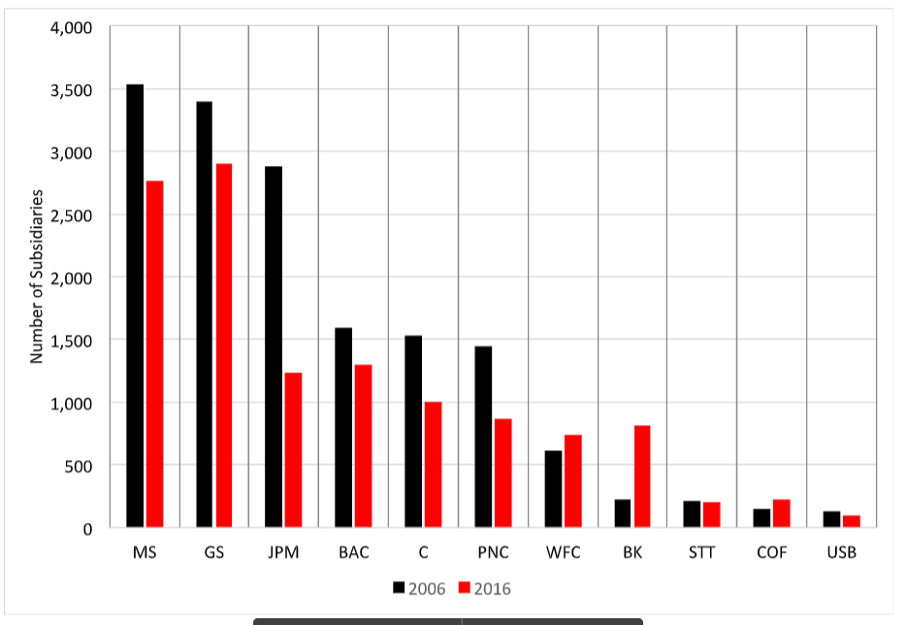
Systemically Important Bank (SIB) Resolution : Organizational Complexity
Notes:
High-Performance Computing, with the adoption of new algorithms and new
computing tools, has improved the learning ability and usability of AI.
Increases in the number of devices and sensors connected to the Internet of
Things are facilitating enormous amounts of data over the Internet.
Big Data generated by digitalized processes at economical prices are helping
accumulate enormous amounts of data, which can then be processed to
generate high-value insights with machine learning.
Artificial intelligence is a misnomer. It's accelerated intelligence. It's about doing things, which historically you thought were impossible for a human being to do, at a blinding speed." (Daniel Nadler, founder of Kensho for Forbes, March 6, 2018).

Slide 6
How has the resolution problem been addressed?
NEW IDEA: Keep operating affiliates untouched and only resolve the Bank Holding Company
That’s what is referred to as Single point of Entry (SPOE)
Notes:
High-Performance Computing, with the adoption of new algorithms and new
computing tools, has improved the learning ability and usability of AI.
Increases in the number of devices and sensors connected to the Internet of
Things are facilitating enormous amounts of data over the Internet.
Big Data generated by digitalized processes at economical prices are helping
accumulate enormous amounts of data, which can then be processed to
generate high-value insights with machine learning.
Artificial intelligence is a misnomer. It's accelerated intelligence. It's about doing things, which historically you thought were impossible for a human being to do, at a blinding speed." (Daniel Nadler, founder of Kensho for Forbes, March 6, 2018).

Slide 7
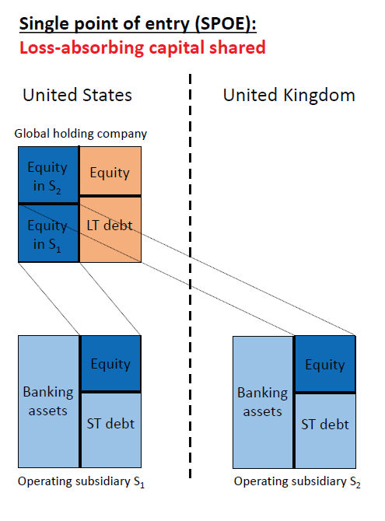
SIB Resolution: Single Point of Entry
Notes:
High-Performance Computing, with the adoption of new algorithms and new
computing tools, has improved the learning ability and usability of AI.
Increases in the number of devices and sensors connected to the Internet of
Things are facilitating enormous amounts of data over the Internet.
Big Data generated by digitalized processes at economical prices are helping
accumulate enormous amounts of data, which can then be processed to
generate high-value insights with machine learning.
Artificial intelligence is a misnomer. It's accelerated intelligence. It's about doing things, which historically you thought were impossible for a human being to do, at a blinding speed." (Daniel Nadler, founder of Kensho for Forbes, March 6, 2018).

Slide 8
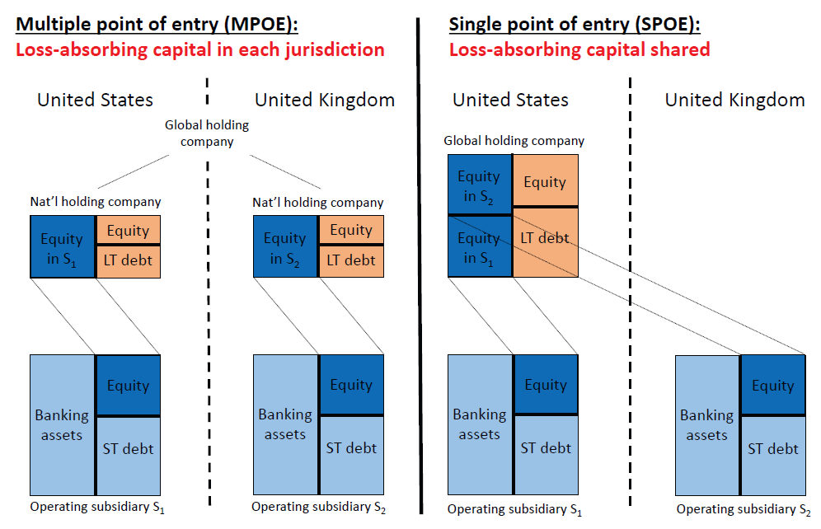
SIB Resolution: Single or Multiple Points of Entry
Notes:
High-Performance Computing, with the adoption of new algorithms and new
computing tools, has improved the learning ability and usability of AI.
Increases in the number of devices and sensors connected to the Internet of
Things are facilitating enormous amounts of data over the Internet.
Big Data generated by digitalized processes at economical prices are helping
accumulate enormous amounts of data, which can then be processed to
generate high-value insights with machine learning.
Artificial intelligence is a misnomer. It's accelerated intelligence. It's about doing things, which historically you thought were impossible for a human being to do, at a blinding speed." (Daniel Nadler, founder of Kensho for Forbes, March 6, 2018).

Slide 9
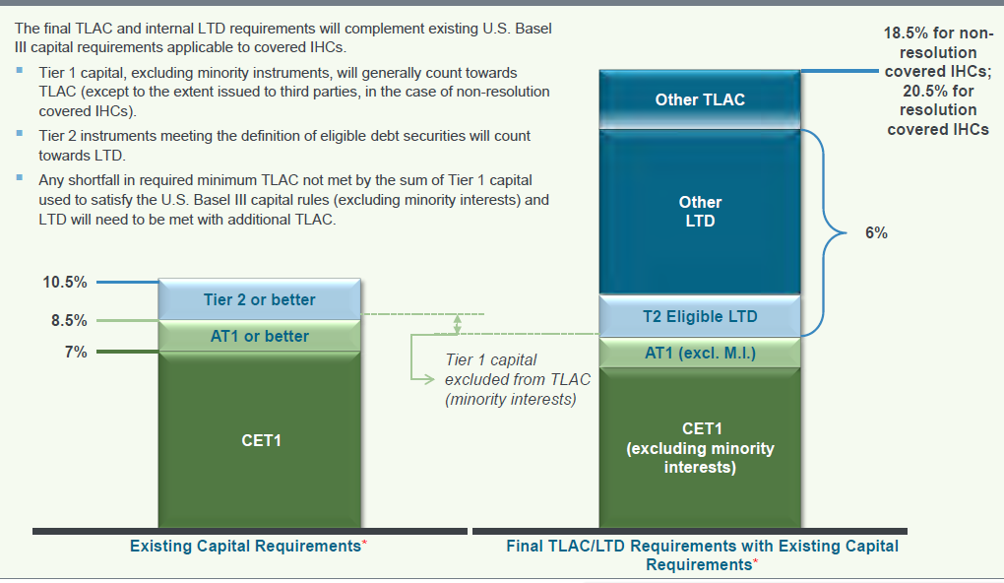
SIB Resolution and Loss absorption
Total loss absorption capacity (TLAC) :
Bailinable
debt
Notes:
High-Performance Computing, with the adoption of new algorithms and new
computing tools, has improved the learning ability and usability of AI.
Increases in the number of devices and sensors connected to the Internet of
Things are facilitating enormous amounts of data over the Internet.
Big Data generated by digitalized processes at economical prices are helping
accumulate enormous amounts of data, which can then be processed to
generate high-value insights with machine learning.
Artificial intelligence is a misnomer. It's accelerated intelligence. It's about doing things, which historically you thought were impossible for a human being to do, at a blinding speed." (Daniel Nadler, founder of Kensho for Forbes, March 6, 2018).

Slide 10
Resolution and Liquidity Support
Bridge financing (DIP financing)
Proscribe public liquidity provision?
Conditional Public liquidity
Notes:
High-Performance Computing, with the adoption of new algorithms and new
computing tools, has improved the learning ability and usability of AI.
Increases in the number of devices and sensors connected to the Internet of
Things are facilitating enormous amounts of data over the Internet.
Big Data generated by digitalized processes at economical prices are helping
accumulate enormous amounts of data, which can then be processed to
generate high-value insights with machine learning.
Artificial intelligence is a misnomer. It's accelerated intelligence. It's about doing things, which historically you thought were impossible for a human being to do, at a blinding speed." (Daniel Nadler, founder of Kensho for Forbes, March 6, 2018).

Slide 11
Taking Stock
SIBs have never been more prepared
Will it work as intended?
Are there any gaps?
Notes:
High-Performance Computing, with the adoption of new algorithms and new
computing tools, has improved the learning ability and usability of AI.
Increases in the number of devices and sensors connected to the Internet of
Things are facilitating enormous amounts of data over the Internet.
Big Data generated by digitalized processes at economical prices are helping
accumulate enormous amounts of data, which can then be processed to
generate high-value insights with machine learning.
Artificial intelligence is a misnomer. It's accelerated intelligence. It's about doing things, which historically you thought were impossible for a human being to do, at a blinding speed." (Daniel Nadler, founder of Kensho for Forbes, March 6, 2018).

Slide 12
Taking Stock 2
SIBs business model is fundamentally changed
SIBs are set up never to fail
Greater pressure on SIB executives, BoDs & supervisors to intervene in a timely way and avoid a build-up of losses

Slide 13
Sound at last?
Assessing a decade of financial regulation
AN EXPANDED ROLE FOR CENTRAL BANKS

Slide 14
Central banks in the crisis
Monetary policy at the Zero Lower Bound (ZLB)
Lender of Last Resort (LOLR) support at unprecedented levels
A new focus on the financial stability component of Central banks’ mandate in light of systemic risk
MESSAGE:
Bigger role for Central Banks demanding an update in their independence status. Not less of it
But adapted to a more visible, active role
Including new missions where coordination and cooperation with other authorities and political validation may be required
Central Bank independence 2.0
Notes:
High-Performance Computing, with the adoption of new algorithms and new
computing tools, has improved the learning ability and usability of AI.
Increases in the number of devices and sensors connected to the Internet of
Things are facilitating enormous amounts of data over the Internet.
Big Data generated by digitalized processes at economical prices are helping
accumulate enormous amounts of data, which can then be processed to
generate high-value insights with machine learning.
Artificial intelligence is a misnomer. It's accelerated intelligence. It's about doing things, which historically you thought were impossible for a human being to do, at a blinding speed." (Daniel Nadler, founder of Kensho for Forbes, March 6, 2018).

Slide 15
Paul Tucker (2018)
“In todays’ democracies the only way to combine effectiveness with legitimacy is transparency around the rules of the game. .. If credible commitment and operating as an emergency institution can be reconciled in principle, getting from ‘in principle’ to ‘in practice’ requires public deliberation and debate, so that the requisite degree of comprehension and support is established”

Slide 16
1. The problem of the policy mix at the ZLB
We review the experience at the ZLB with an eye on the possibility that it gives us a taste of the future
Conclude that going forward there is a need to adapt central banks’ status to facilitate policy coordination at the ZLB!
Proposal: Reaching and leaving the ZLB should define a special regime where open discussions between the government and the Central Bank (in view of coordinating policies) are encouraged and institutionalized, i.e., rethink the practice of independence at the ZLB
Notes:
High-Performance Computing, with the adoption of new algorithms and new
computing tools, has improved the learning ability and usability of AI.
Increases in the number of devices and sensors connected to the Internet of
Things are facilitating enormous amounts of data over the Internet.
Big Data generated by digitalized processes at economical prices are helping
accumulate enormous amounts of data, which can then be processed to
generate high-value insights with machine learning.
Artificial intelligence is a misnomer. It's accelerated intelligence. It's about doing things, which historically you thought were impossible for a human being to do, at a blinding speed." (Daniel Nadler, founder of Kensho for Forbes, March 6, 2018).

Slide 17
2. LOLR
Never before practiced on this scale
Surprise, awe and backlash. Negative reactions, the outcome of opacity, itself the consequence of constructive ambiguity
Need to strengthen the democratic acceptability of delegating such powers to unelected officials
Abandon ambiguity: clarifying the mandate and making precise the range and scope of potential interventions of the LOLR
Risk: curtailing the ability to act; e.g., Dodd-Frank limits the scope of actions of the FED: Bernanke-Geithner-Paulson Op-ed of September 2018
Not inevitable: The BOE as an example
Notes:
High-Performance Computing, with the adoption of new algorithms and new
computing tools, has improved the learning ability and usability of AI.
Increases in the number of devices and sensors connected to the Internet of
Things are facilitating enormous amounts of data over the Internet.
Big Data generated by digitalized processes at economical prices are helping
accumulate enormous amounts of data, which can then be processed to
generate high-value insights with machine learning.
Artificial intelligence is a misnomer. It's accelerated intelligence. It's about doing things, which historically you thought were impossible for a human being to do, at a blinding speed." (Daniel Nadler, founder of Kensho for Forbes, March 6, 2018).

Slide 18
2. LOLR
2. Pricing liquidity insurance. How?
Beware of outsized role of Central banks in credit allocation process
Beware of exacerbating the preference for collateralized credits
A valid question, further analysis needed.
Subsidy to banks: ground for regulating remunerations (as made possible by Dodd-Frank)
Notes:
High-Performance Computing, with the adoption of new algorithms and new
computing tools, has improved the learning ability and usability of AI.
Increases in the number of devices and sensors connected to the Internet of
Things are facilitating enormous amounts of data over the Internet.
Big Data generated by digitalized processes at economical prices are helping
accumulate enormous amounts of data, which can then be processed to
generate high-value insights with machine learning.
Artificial intelligence is a misnomer. It's accelerated intelligence. It's about doing things, which historically you thought were impossible for a human being to do, at a blinding speed." (Daniel Nadler, founder of Kensho for Forbes, March 6, 2018).

Slide 19
3. Updating the financial stability mandate
An expanded role for Central banks
Should financial stability become the core of central banks’ mandate?
Is this compatible with independence?
Or is a narrow price stability mandate best suited for a technocratic institution with independent status?
How to organize cooperation among authorities for financial stability?
Notes:
High-Performance Computing, with the adoption of new algorithms and new
computing tools, has improved the learning ability and usability of AI.
Increases in the number of devices and sensors connected to the Internet of
Things are facilitating enormous amounts of data over the Internet.
Big Data generated by digitalized processes at economical prices are helping
accumulate enormous amounts of data, which can then be processed to
generate high-value insights with machine learning.
Artificial intelligence is a misnomer. It's accelerated intelligence. It's about doing things, which historically you thought were impossible for a human being to do, at a blinding speed." (Daniel Nadler, founder of Kensho for Forbes, March 6, 2018).

Slide 20
3. What role for Central banks?
All under one roof? The “encompassing model” (BOE)
Clarity and accountability
Effectiveness (notably in managing trade-offs when divergences between price and financial stability objectives)
Credibility risk if failure
Legitimacy? Paul Tucker (2018)
Taking the bull by the horns!
Or a “cooperative model” where the Central Bank focuses on price stability and shares with other authorities responsibility for financial stability?
Legitimacy is less of an issue
Questions of coordination among authorities, notably for an independent Central bank
And of accountability (inaction bias)
Thus effectiveness?
In reality, the encompassing model is the exception more than the rule. Take it as a given. Challenges demand stronger institutional arrangements
Notes:
High-Performance Computing, with the adoption of new algorithms and new
computing tools, has improved the learning ability and usability of AI.
Increases in the number of devices and sensors connected to the Internet of
Things are facilitating enormous amounts of data over the Internet.
Big Data generated by digitalized processes at economical prices are helping
accumulate enormous amounts of data, which can then be processed to
generate high-value insights with machine learning.
Artificial intelligence is a misnomer. It's accelerated intelligence. It's about doing things, which historically you thought were impossible for a human being to do, at a blinding speed." (Daniel Nadler, founder of Kensho for Forbes, March 6, 2018).

Slide 21
3. In need of stronger institutional arrangements
In view of insuring the legitimacy of delegating increasingly broad powers to an independent unelected institution and
To ensure an effective cooperation among authorities
Proposal: Clarify the modus operandi of the Financial Stability Committee or equivalent body and adopt the standards of communication prevailing in the monetary domain, mutatis mutandis.
Notes:
High-Performance Computing, with the adoption of new algorithms and new
computing tools, has improved the learning ability and usability of AI.
Increases in the number of devices and sensors connected to the Internet of
Things are facilitating enormous amounts of data over the Internet.
Big Data generated by digitalized processes at economical prices are helping
accumulate enormous amounts of data, which can then be processed to
generate high-value insights with machine learning.
Artificial intelligence is a misnomer. It's accelerated intelligence. It's about doing things, which historically you thought were impossible for a human being to do, at a blinding speed." (Daniel Nadler, founder of Kensho for Forbes, March 6, 2018).

